Slide 2
What’s New with Chef?
Nathen Harvey
@nathenharvey

Slide 3


Nathen Harvey
nharvey@chef.io
@nathenharvey
Co-organizer – DevOps DC
http://bit.ly/farmer-nathen (explicit)
http://bit.ly/farmer-nathen-sfw

Slide 4
Agenda
Chef 12
CYOA
Q & A

Slide 5
Chef 12

Slide 6

What’s NOT in Chef 12?

Slide 7
What’s NOT in Chef 12?
Differentiation between Open Source & Enterprise Chef Server
WebUI – The OSS WebUI has been completely deprecated. WebUI is now a premium-only add-on.
Support for Ruby < 2.0.
Daemonized clients can no longer be run with --no-fork.
CouchDB is 100% gone (was previously still part of Enterprise Chef).
Whole Buncha daemons got the axe: opscode-account, opscode-certificate, oc_authz_migrator, opscode-org-creator, orgmapper.

Slide 8

What’s New in Chef Server 12?

Slide 9
The Chef World Has Grown
New OSS since Chef 11 Launch:
Chef Development Kit
Test Kitchen
Chef Provisioning (née Chef-Metal)
Powershell DSC Support
Chef-zero (--local-mode)
Supermarket
Push Jobs Went Open Source!

Slide 10
The Chef World Has Grown
New Premium Features since Chef 11 Launch:
Chef Analytics
Chef Reporting
Chef Management Console
Chef Server Replication
Chef Server Pluggable HA

Slide 11
Changes in the Chef Community
RFC Process – Get involved!
https://github.com/opscode/chef-rfc
Supermarket
https://supermarket.chef.io
LearnChef
https://learn.chef.io
Switch to Github Issues

Slide 12
The Big Deal With Chef Server 12
No more difference between OSS and Enterprise Chef Server 12
There is one Chef Server, and it is open source.
Once-premium features are now free for everybody:
Multi-tenancy (“Organizations”)
Role-based access controls
Push Jobs Server & Client
All Premium features are free up to 25 nodes
Toggling Premium Features is one command.
chef-server-ctl install opscode-manage
chef-server-ctl remove opscode-manage

Slide 13
There is One Chef Server, And it is Open Source
People had to choose up front whether to use OSS Chef Server, Chef-solo, or Chef Enterprise
If you chose Chef-solo, odds are good you wound up re-implementing at least half the server anyway, and this weird competition developed because people thought that Chef the company wanted you to buy servers
Changing your mind later was hard!
Over time, Enterprise Chef got all the fancy new hotness, and OSS Chef went for months without a release.

Slide 14
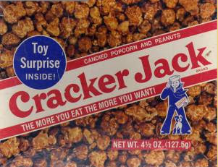
Enterprise Chef Features Are Now Free
Multi-tenancy (“Organizations”)
Like having multiple chef servers on your Chef Server
Role-based access controls
ACLs on every single item in the Chef Server datastore
Push Jobs
Once the client is in place, hit the /jobs API and kick off on-demand scripts

Slide 15
The Big Deal With Chef Server 12
chef-server-ctl now manages users, permissions, & organizations
SOLR4 under the hood for much faster search indexing (typically < 1s)
Chef Identity for authenticating external apps such as Supermarket & Analytics
25% reduction in running services, 20% reduction in package size
Full Release Notes:
https://docs.chef.io/server/release_notes.html

Slide 16
The Big Deal With Chef Client 12
SSL Key Verification by default
AIX Support
Homebrew is default package manager for OSX
Easier encrypted data bags in recipes with data_bag_item()
Client-side key generation
Windows DSC Support
“Partial Search” integrated into main client, no need for cookbook
Full Release Notes:
https://docs.chef.io/server/release_notes.html

Slide 17



Chef 12 Delivers
 | Single Code Base | Converges open-source and premium features using a unified code base Supports open-source innovation and delivers that value to commercial users. | Open source community benefits from timely bug fixes and improvements. Commercial customers get enterprise features and commercial support for open-source tools.
 | Enterprise Capabilities | Analytics High availability and replication Management console Chef development kit Commercial support for test-driven infrastructure | Visibility Uptime Consistency Ease of use Reliability
 | Ecosystem Integration | Windows PowerShell DSC VMware vCloud Air AWS Cloud | Native integration with DSC and Azure. Easily automate vSphere and vCloud workloads. Automate AWS and use AWS Storage for replication.
Notes:
Chef 12 delivers a single, open-source code base augmented by premium features, enabling maximum open-source innovation and delivering that value for commercial customers.
Single Code Base
Open source users can easily upgrade to premium features without reinstallation.
Commercial customers can disable premium features if their needs change.
Inclusive Model
Three usage tiers all based on a single code base to address the entire range of customer needs.
Makes experience seamless for entire range of users.
Enterprise Capabilities
Enterprise-focused software features and an unprecedented level of proactive engagement and support
Accelerates and de-risks the enterprise adoption of DevOps and the journey to web speed and scale.
Ecosystem Integration
Strengthen Chef’s position as the foremost platform for automating IT infrastructure and application delivery across Windows, Linux, and Unix, in the data center or on any combination of cloud platforms.
Easy to manage heterogeneous and/or hybrid environments across all primary enterprise operating systems, virtualization technologies, and cloud platforms.

Slide 18
The Chef Software Platform
Management Console
High Availability and Replication
Analytics
Platform
Chef
Client Nodes
Data Center
Chef Server
Chef Development Kit
The Cloud
Cookbook and Policy Authoring
Test-Driven Infrastructure
Notes:
Read this diagram from left to right, bottom to top, as follows:
Systems Administrators and Software Developers write Cookbooks and Policy describing how to build, deploy, and manage infrastructure and applications as code
They use best-of-breed tools to test their changes before publishing them, ensuring quality throughout the entire technology stack
They publish to a Chef Server, which stores the cookbooks and policy and scalably distributes them
Less technical users can set policy and configure infrastructure and applications through our web based management console - not everyone is an author
The Chef Server can be made highly available within a single failure domain, and multiple failure domains (such as between data centers) can be replicated
Activity on the Chef Server is tracked by our analytics platform - every API call and user interaction is stored
Chef Client Nodes (a Server, VM, or Container) retrieve policy from the Chef Server, configure themselves appropriately, and submit information about their state to the chef server, where they are indexed for search
All information about what changed on a node is stored in our analytics platform - every resource, recipe, and policy application, for every run
WE COVER THE WHOLE EXPERIENCE - FROM DEVELOPER LAPTOP TO PRODUCTION SERVER

Slide 19
CYOA
High Availability
Replication
Client / Server Compatibility
AIX
Partial Search
Platform-specific values
Encrypted Databags
shell_out
OS X
Windows
Client-side key generation
Supermarket
Ruby versions
Chef Analytics
Chef Development Kit
Chef Provisioning
Roadmap
Chef in DC
Ask me Anything

Slide 20
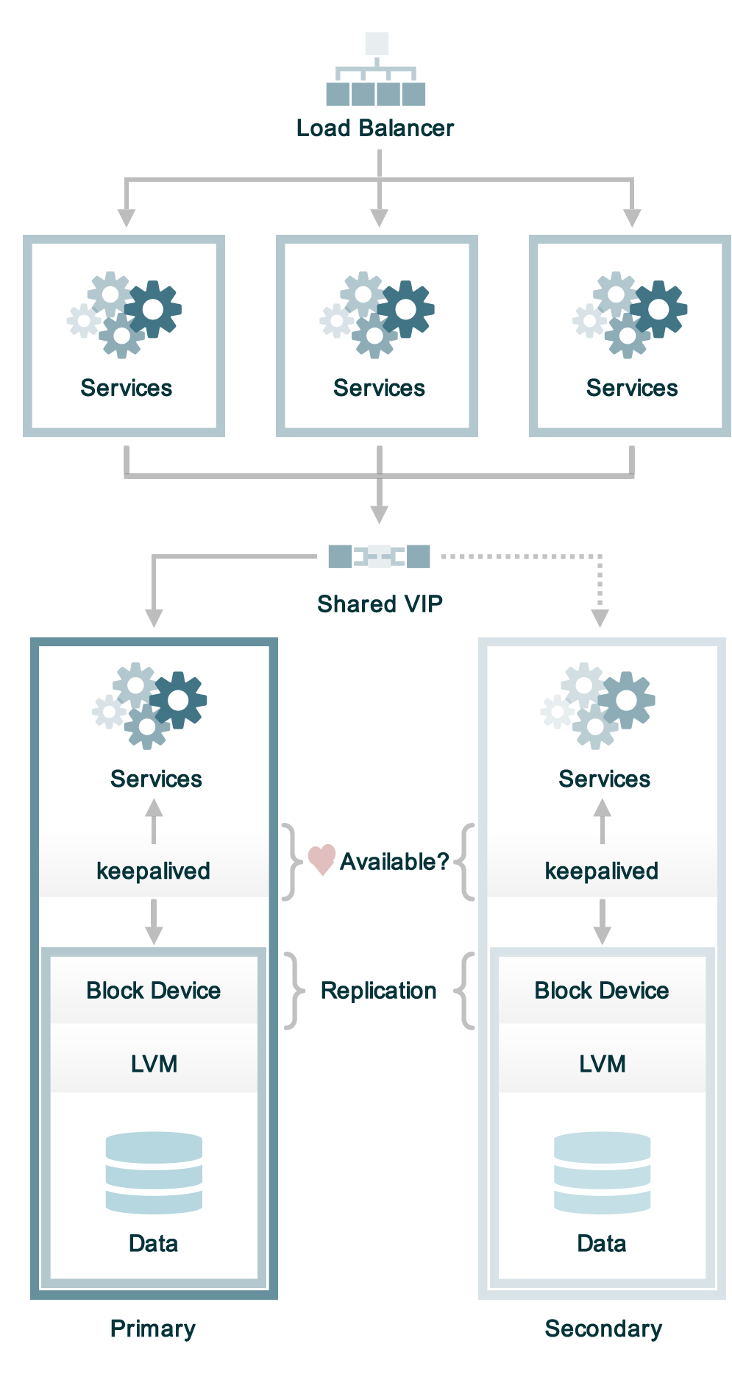
High Availability
Maximum uptime
Maximum system availability
Works in data center and cloud environments
Chef continues to run without interruption even if primary node fails
Minimizes the chance of build-related delays in your delivery pipeline
Notes:
2014-10-06
-----------------
Today two types of HA are supported, DRBD and EBS-backed AWS. “BYOD” or Bring Your Own Block Device is planned for the future but there are no implementations yet. Ideally SAN storage will be supported in the future.
What is HA?
High availability means that you should be able to unplug any component in the above diagram without interrupting service. If either one of the back-end servers goes down the Chef server API should always remain available. HA is ideal for companies that absolutely must have their Chef server up and running all the time. If a 60-90 minute downtime is acceptable to the customer, they can often get by without HA and simply have a plan to quickly rebuild the Chef server if it fails.
Front-end servers scale horizontally, eg, by adding more front-end hosts to support additional load.
Back-end servers scale vertically, by adding more CPU and memory.
What is it not?
HA is not a substitute for backups, nor is it a disaster recovery solution.
The failure domain is within the same data center, or AWS availability zone.

Slide 21
CYOA
High Availability
Replication
Client / Server Compatibility
AIX
Partial Search
Platform-specific values
Encrypted Databags
shell_out
OS X
Windows
Client-side key generation
Supermarket
Ruby versions
Chef Analytics
Chef Development Kit
Chef Provisioning
Roadmap
Chef in DC
Ask me Anything

Slide 22
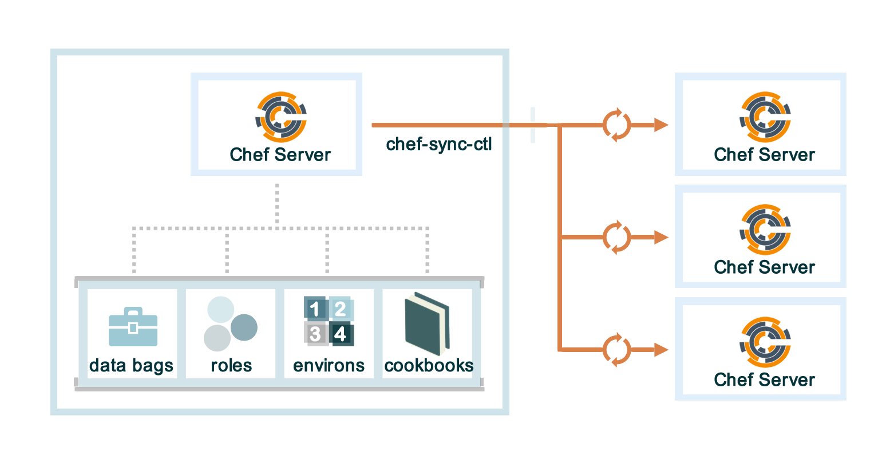
Replication
Consistency Across Global Systems
Easily manage globally distributed infrastructure from single view
Chef servers in different clusters / data centers / regions asynchronously replicate from a Master Chef server
Infrastructure is consistent across all locations
Notes:
2014-10-06
-----------------
As of today, replication of cookbooks, roles, environments and data bags works.
Node objects and clients are not synchronized to the replicas.
Each of the servers in the diagram in the slide has it’s own nodes and clients.
Replicas are read only.

Slide 23
CYOA
High Availability
Replication
Client / Server Compatibility
AIX
Partial Search
Platform-specific values
Encrypted Databags
shell_out
OS X
Windows
Client-side key generation
Supermarket
Ruby versions
Chef Analytics
Chef Development Kit
Chef Provisioning
Roadmap
Chef in DC
Ask me Anything

Slide 24
Chef Client and Chef Server Compatibility Matrix
 | Server Versions
Client Versions | Enterprise Chef > 11.1.8 | Open Source > 11.1.0 | Chef Server 12
11.x | ✓ | ✓ | ✓
12.x | ✓ | ✓ | ✓
No longer supported as of Chef Client 12: Chef Client 0.10.x, 10.x
No longer supported as of Chef Server 12: Private Chef 1.4.x
Notes:
The point to make here is that client 12 does not force you to be on server 12.
TODO: Put support matrix from the server in here per Stephen Delano's email.

Slide 25
CYOA
High Availability
Replication
Client / Server Compatibility
AIX
Partial Search
Platform-specific values
Encrypted Databags
shell_out
OS X
Windows
Client-side key generation
Supermarket
Ruby versions
Chef Analytics
Chef Development Kit
Chef Provisioning
Roadmap
Chef in DC
Ask me Anything

Slide 26
New Platform: IBM AIX
Chef Client 12 supports IBM AIX 6.1 and 7.1
Freely-available BFF installer
Feature highlights:
Manage both SRC and init-system-based services
Install both BFF and RPM packages
Mount JFS2 disks and NFS shares and manage fstab
Native user and group management
Compiled with IBM XL C/C++ for binary compatibility with future AIX versions
Notes:
Call out that we did this in partnership with IBM to support enterprise workloads on AIX. Popular demand from customers.
FAQs you might get asked here:
Linux ppc64 support – yes, we are working on it
LPAR/HMC automation – have done some research, waiting for more customer demand
Pricing? AIX nodes (LPARs) are licensed just like any other platform. We don't charge a premium.
Link to blog post when it comes out

Slide 27
CYOA
High Availability
Replication
Client / Server Compatibility
AIX
Partial Search
Platform-specific values
Encrypted Databags
shell_out
OS X
Windows
Client-side key generation
Supermarket
Ruby versions
Chef Analytics
Chef Development Kit
Chef Provisioning
Roadmap
Chef in DC
Ask me Anything

Slide 28
Native Partial Search
search(:node,
"role:web",
:filter_result => {
'name' => [ 'name' ],
'ip' => [ 'ipaddress' ]
}
).each do |result|
Chef::Log.debug("I found a #{result['ip']} & #{result['name']}")
end
Notes:
This does server-side filtering of results to cut down the amount of JSON sent around from client-to-server.
This functionality replaces the API that was in the partial_search cookbook, which is now no longer needed.
Knife search also gets a –filter-result command-line argument to which you supply a comma-separated list of filter criteria.
Chef 11.x
metadata.rb
depends "partial_search"
recipe.rb
search(:node,
"role:web",
:filter_result => {
'name' => [ 'name' ],
'ip' => [ 'ipaddress' ]
}
).each do |result|
Chef::Log.debug("I found a #{result['ip']} & #{result['name']}")
end

Slide 29
CYOA
High Availability
Replication
Client / Server Compatibility
AIX
Partial Search
Platform-specific values
Encrypted Databags
shell_out
OS X
Windows
Client-side key generation
Supermarket
Ruby versions
Chef Analytics
Chef Development Kit
Chef Provisioning
Roadmap
Chef in DC
Ask me Anything

Slide 30
Handling Platform-specific values
apache_package = "httpd"
case node["platform"]
when "ubuntu"
apache_package = "apache2"
when "centos"
apache_package = "httpd"
end
package apache_package do
action :install
end

Slide 31
value_for_platform
apache_package = value_for_platform(
"ubuntu" => "apache2",
"centos" => "httpd"
)
package apache_package do
action :install
end
Notes:
11.x

Slide 32
value_for_platform accepts >=, <=, etc.
mysql_version = value_for_platform(
["centos", "redhat", "oracle"] => {
'<= 5.0' => '4.3.21',
'6.0' => '5.5.23',
'>= 7.0' => '6.3.20'
}
)
Notes:
It used to be that value_for_platform in the DSL only accepted the platform name and not version numbers, so now it does.
These are made up values. Don't actually use this recipe code!

Slide 33
CYOA
High Availability
Replication
Client / Server Compatibility
AIX
Partial Search
Platform-specific values
Encrypted Databags
shell_out
OS X
Windows
Client-side key generation
Supermarket
Ruby versions
Chef Analytics
Chef Development Kit
Chef Provisioning
Roadmap
Chef in DC
Ask me Anything

Slide 34
Encrypted Databags pre 12.x
# load encrypted data bag item
Chef::EncryptedDataBagItem.load("passwords", "mysql")
# load normal data bag item
data_bag_item("users", "mysql")

Slide 35
Automatic Encrypted Data Bag Support
# Provide a secret
data_bag_item('passwords', 'private', '/etc/some/secret.key')
# Auto-detect encrypted item and use default secret
data_bag_item('passwords', 'private')
Notes:
The implications of this change are that you no longer need to change recipe code when you decide you want to encrypt data bag items. Also, the code is much easier to read.
The default secret is Chef::Config[:encrypted_data_bag_secret]
See diff: https://github.com/opscode/chef/pull/1853/files

Slide 36
CYOA
High Availability
Replication
Client / Server Compatibility
AIX
Partial Search
Platform-specific values
Encrypted Databags
shell_out
OS X
Windows
Client-side key generation
Supermarket
Ruby versions
Chef Analytics
Chef Development Kit
Chef Provisioning
Roadmap
Chef in DC
Ask me Anything

Slide 37
shell_out and shell_out! part of DSL
execute 'make Dan Walsh happy' do
command 'setenforce Enforcing'
only_if { shell_out('getenforce").stdout =~ "Disabled" }
end
Use shell_out! to raise exceptions on fatal errors
Use shell_out_with_systems_locale to escape UTF-8 normalization
Never use Process.spawn, backticks, popen4, etc. to run shell commands!
Notes:
More on shell_out_with_systems_locale: Chef Client 12 fixes all encoding issues by forcing UTF-8 on the run, even if the system locale is set to something else (e.g. "C")
Use shell_out in all situations where you need to shell out. Never use Process.spawn, backticks, etc. as those aren't a) unit testable and b) don't handle all the cross-platform UNIX/Windows quirks that we have incorporated in mixlib-shellout!!!

Slide 38
CYOA
High Availability
Replication
Client / Server Compatibility
AIX
Partial Search
Platform-specific values
Encrypted Databags
shell_out
OS X
Windows
Client-side key generation
Supermarket
Ruby versions
Chef Analytics
Chef Development Kit
Chef Provisioning
Roadmap
Chef in DC
Ask me Anything

Slide 39
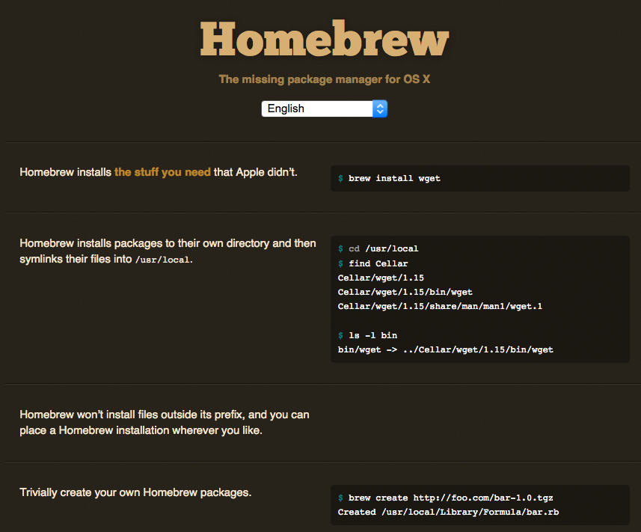
Homebrew Provider is Default
Chef Client 11 and below use MacPorts as default package provider
Chef Client 12 uses Homebrew

Slide 40
User Password Management Improvements
dscl user provider supports OS X 10.7, 10.8+
10.7: Password scheme is SALTED-SHA512
10.8+: Password scheme is SALTED-SHA512-PBKDF2
Pass 'salt' and 'iterations' attributes to 10.8+
Examples and more info:
http://docs.chef.io/release/12-0/release_notes.html#mac-os-x-passwords
Notes:
There are improvements to the 'group' provider too to use dscl, which you can mention if it comes up.

Slide 41
CYOA
High Availability
Replication
Client / Server Compatibility
AIX
Partial Search
Platform-specific values
Encrypted Databags
shell_out
OS X
Windows
Client-side key generation
Supermarket
Ruby versions
Chef Analytics
Chef Development Kit
Chef Provisioning
Roadmap
Chef in DC
Ask me Anything

Slide 42
Client-Side Key Generation
Chef Client <= 11: Generate all keys server-side
Client-side key generation is possible with config option, but not default
Chef Client 12: Clients generate their own public/private keys and send them to the server
Notes:
Note, this is why users must have a Chef Server of at least the 11-series since it requires a new API endpoint. Everything in the first slide about the compat matrix holds

Slide 43
CYOA
High Availability
Replication
Client / Server Compatibility
AIX
Partial Search
Platform-specific values
Encrypted Databags
shell_out
OS X
Windows
Client-side key generation
Supermarket
Ruby versions
Chef Analytics
Chef Development Kit
Chef Provisioning
Roadmap
Chef in DC
Ask me Anything

Slide 44
Minimum Ruby Versions
Minimum Ruby is 2.0.0
Chef's full-stack installers bundle:
Ruby 2.1.5+ on UNIX/Linux
Ruby 2.0.0+ on Windows
More information: https://github.com/opscode/chef-rfc/blob/master/rfc034-ruby-193-eol.md

Slide 45
CYOA
High Availability
Replication
Client / Server Compatibility
AIX
Partial Search
Platform-specific values
Encrypted Databags
shell_out
OS X
Windows
Client-side key generation
Supermarket
Ruby versions
Chef Analytics
Chef Development Kit
Chef Provisioning
Roadmap
Chef in DC
Ask me Anything

Slide 46
Chef Analytics

Slide 47


Computing Resources Have Been Increasing Exponentially
Millions
120
Virtual Nodes
Physical Hardware
100
80
Millions of Servers
60
1980
Mainframe
1990
Client/Server
2000
Datacenter
2010+
Web-Scale
40
20
Notes:
Frame the problem
- growing infrastructure
- fewer resources
- can't watch everything
- surface problems faster

Slide 48
Increase Size Leads to Operational Complexity
WEB SERVERS
ADD 1 SERVER
APPLICATION SERVERS
20+ Changes
12+ New dependences
DATABASE
Notes:
----- Meeting Notes (9/15/14 13:28) -----
- infrastructure more dynamic
- higher rate of change requires more data to allow for safety

Slide 49
To Operate at Velocity, Teams Need Visibility
SECURITY LOGS
AUDITING
PERFORMANCE MONITORING
CHANGE TRACKING

Slide 50
Chef Analytics keeps your finger on the pulse of your infrastructure.

Slide 51
Chef Analytics Provides Visibility in Three Ways
TRACK CHANGES FROM ALL SOURCES
Chef Server Policy (Actions)
Chef Client Runs (Run History)
Node state (Audit Controls)
NOTIFICATIONS
Built-in messaging and email integration
Extend notifications to your existing systems
REAL-TIME VISIBILITY
Simple dashboard with search, filters and sorting options
Integrate with existing tools via API
Notes:
- Policy is cookbook, role, environment

Slide 52
Chef Analytics History
Launched in May 2014
Adds new fundamental data collection components
Builds on reporting (run history) feature shipped in 2013
Actions – track policy modifications on the Chef Server
Controls – assert the state of your infrastructure
Pluggable analytics pipeline
Delivered as premium feature of Chef 12
Rules and Notifications

Slide 53
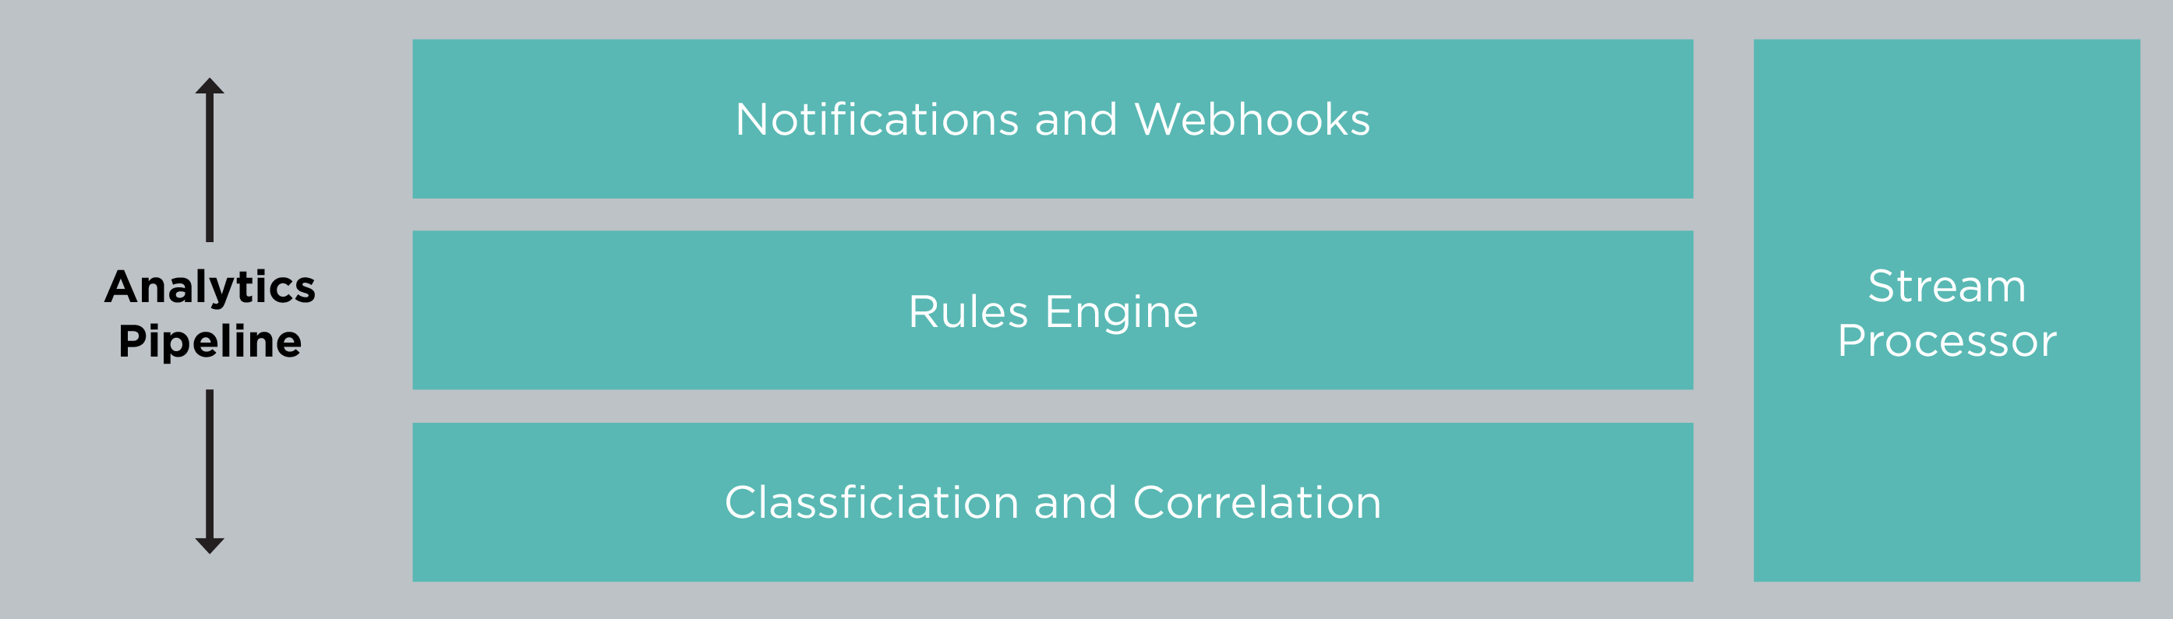
Chef Analytics Architecture

Slide 54
Chef Analytics Data Flow
Chef Server
Reporting
WebUI
Actions
Runs
Analytics
Pipeline
Analytics API
Notifications
Data Store
HipChat
PostgreSQL

Slide 55
Actions – Who did what and when?
Provide a read-only view of what happened
Allow administrators to react to events as they happen or after the fact investigation
Can be customized to meet audit and compliance reporting requirements

Slide 56
Reporting – What changed during Chef runs ?
Single view of what changed
Success/failure status of individual Chef Client runs
Rollups of success and failure counts
Rollups of run durations over time
Drill-down detail to individual resource convergence
State before and after convergence
Resource Diffs (e.g. for templates, files)
Error messages and stack traces

Slide 57
Audit Controls
Continually assess the baseline of your system
Create IT Controls on the state of a node
Package installations and version information, file contents, running services, open ports, registry keys, users and groups
Multiple uses
Audit and Compliance
Unmanaged fleet migration
Separation of Controls
Allows for separation of controls via integration with Chef role based access controls
Notes:
“When someone not in the ‘siteops’ group modifies the DNS cookbook, alert the siteops team via email to siteops@example.com”
“When the /etc/ssh/ssh_config file is modified, raise audit rule 24.1”

Slide 58
Notifications
Adds a language which allows you to express rules on all Chef events
Runs
Resource convergence
Actions
Controls
Extensible for your business requirements
Build custom rules that match your infrastructure and team
Send to different external data sinks
Messaging systems, e.g. HipChat, SMTP
Extensible to anything that supports webhook notifications

Slide 59
2014 Analytics Roadmap
Q2
Q3
Q4
Q1
May
Initial RC
July
1.0 GA Release
December
1.1 Beta
January
1.1 GA Release

Slide 60
What’s next?
Integrate with more Chef data sources
Chef Solo
Push Jobs
Chef Provisioning
Add more data integrations
Splunk, AWS analytics stack, PagerDuty, …
Enhanced Compliance tools
Enhanced audit and compliance reporting
Content for auditing against specific compliance regimes (PCI, SOX, …)

Slide 61
How You Can Get Analytics
Available as a Premium Feature of Chef Server
Supported on Enterprise Chef 11.2 and Chef Server 12
Included in Chef Subscription
Also available free for installations less than 25 nodes
Installation instructions
https://docs.getchef.com/install_analytics.html
Download from https://downloads.getchef.com/

Slide 62
Product screens

Slide 63
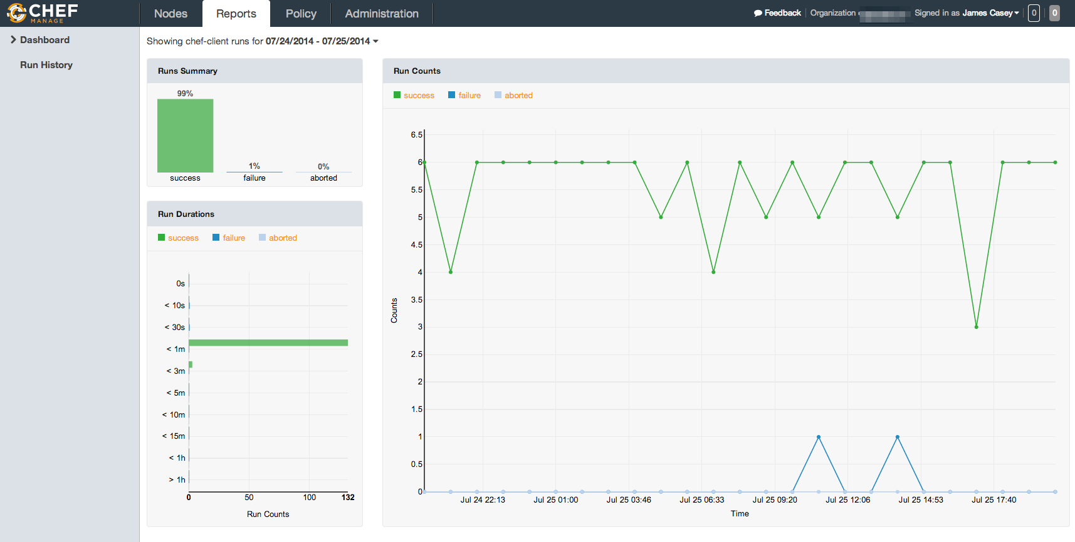

Slide 64
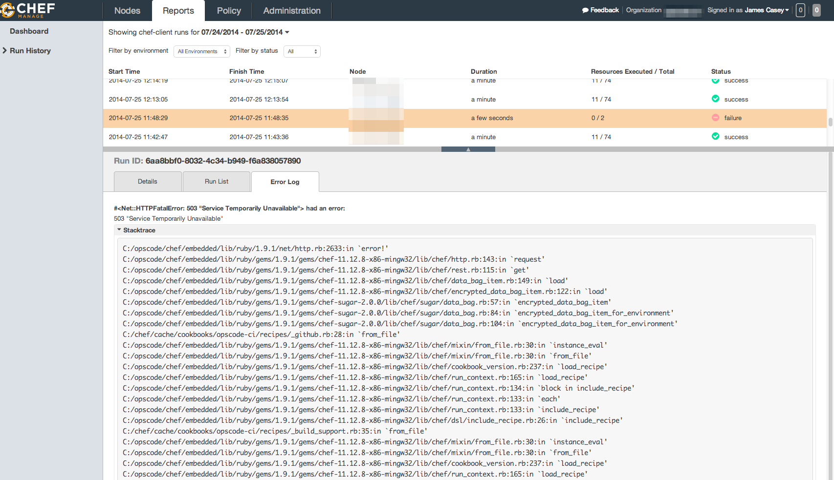

Slide 65
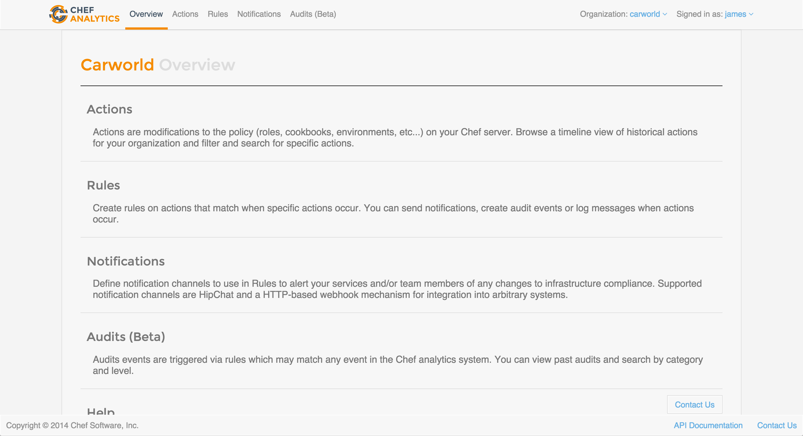

Slide 66
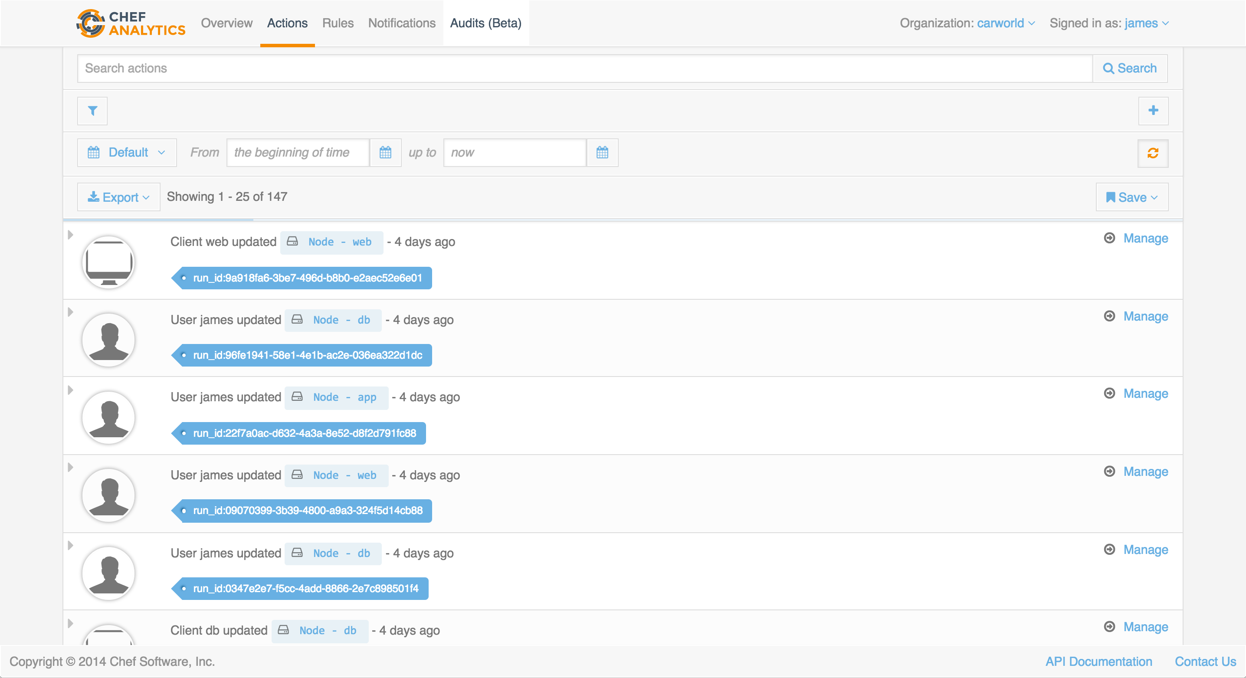

Slide 67
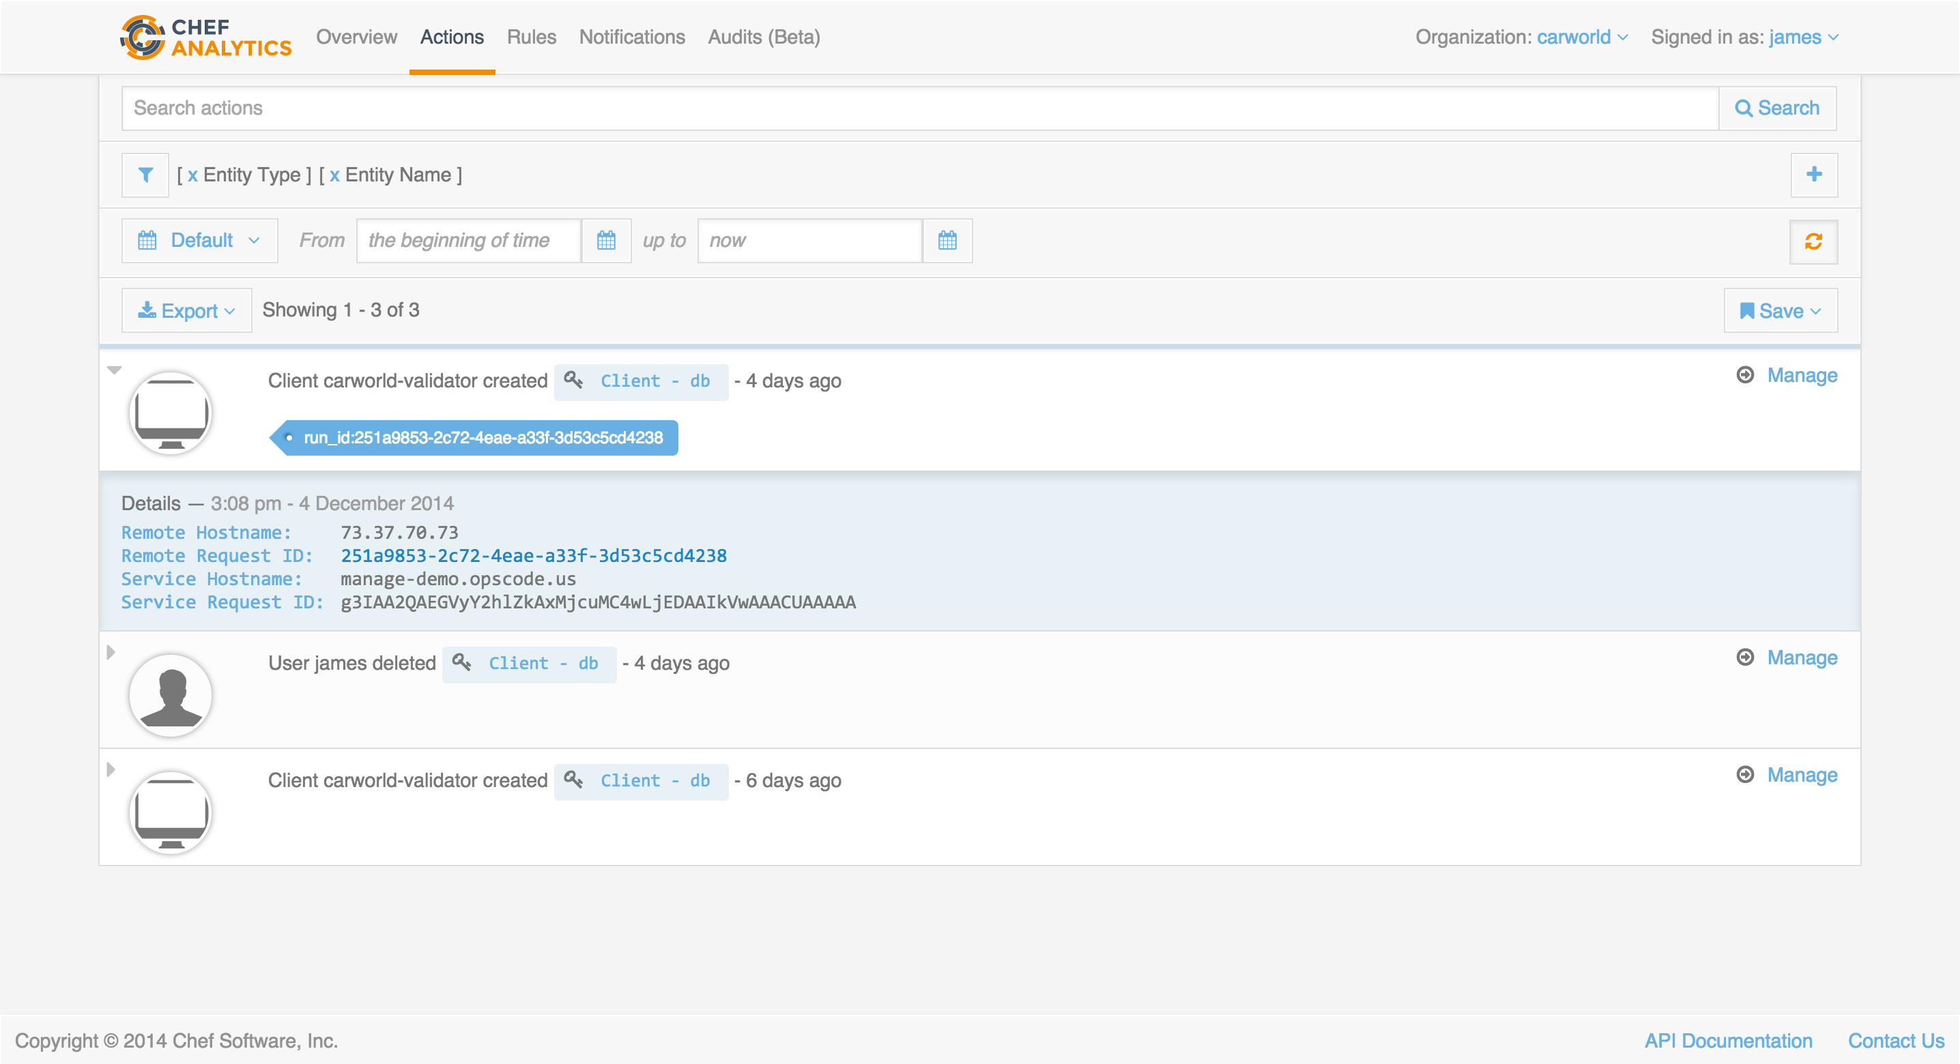

Slide 68
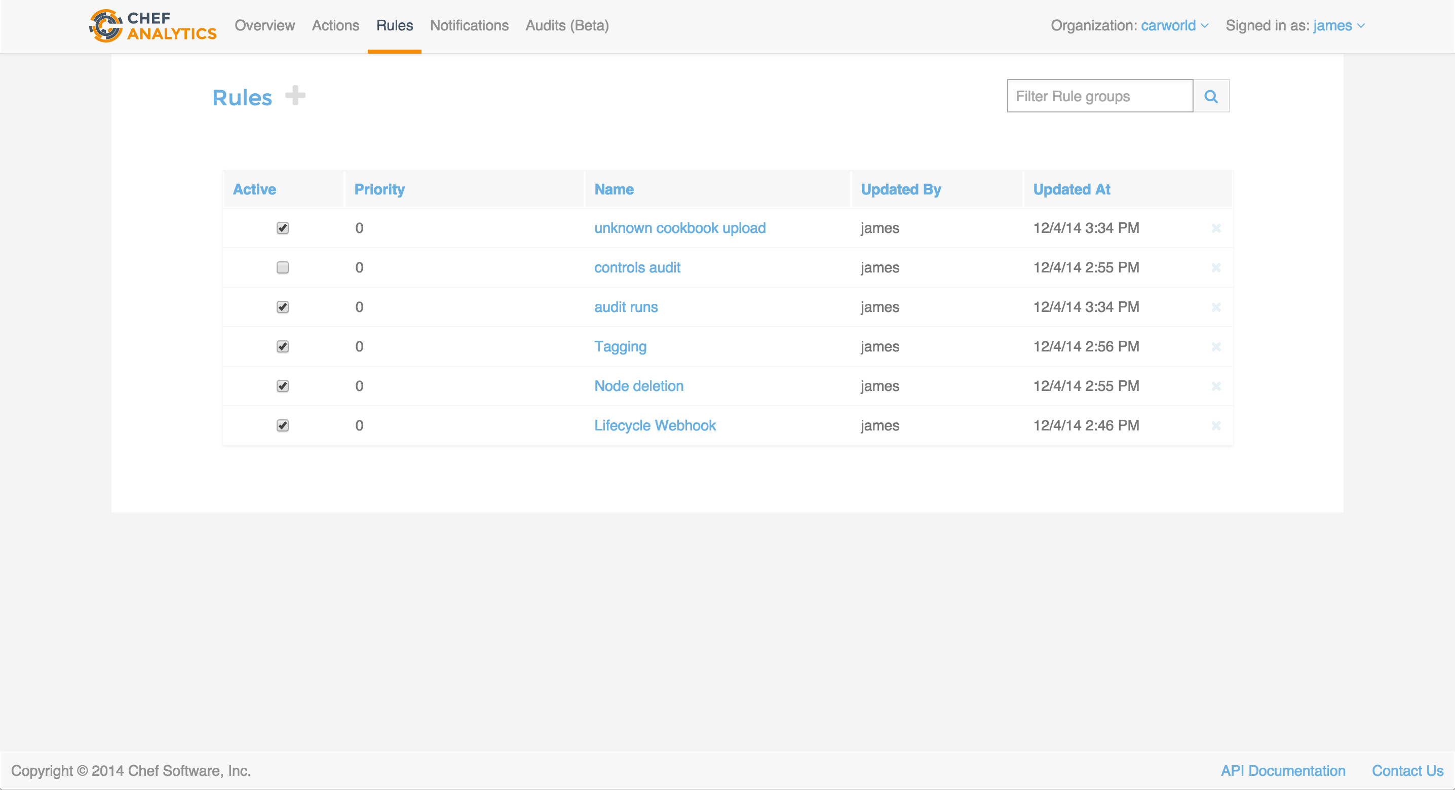

Slide 69
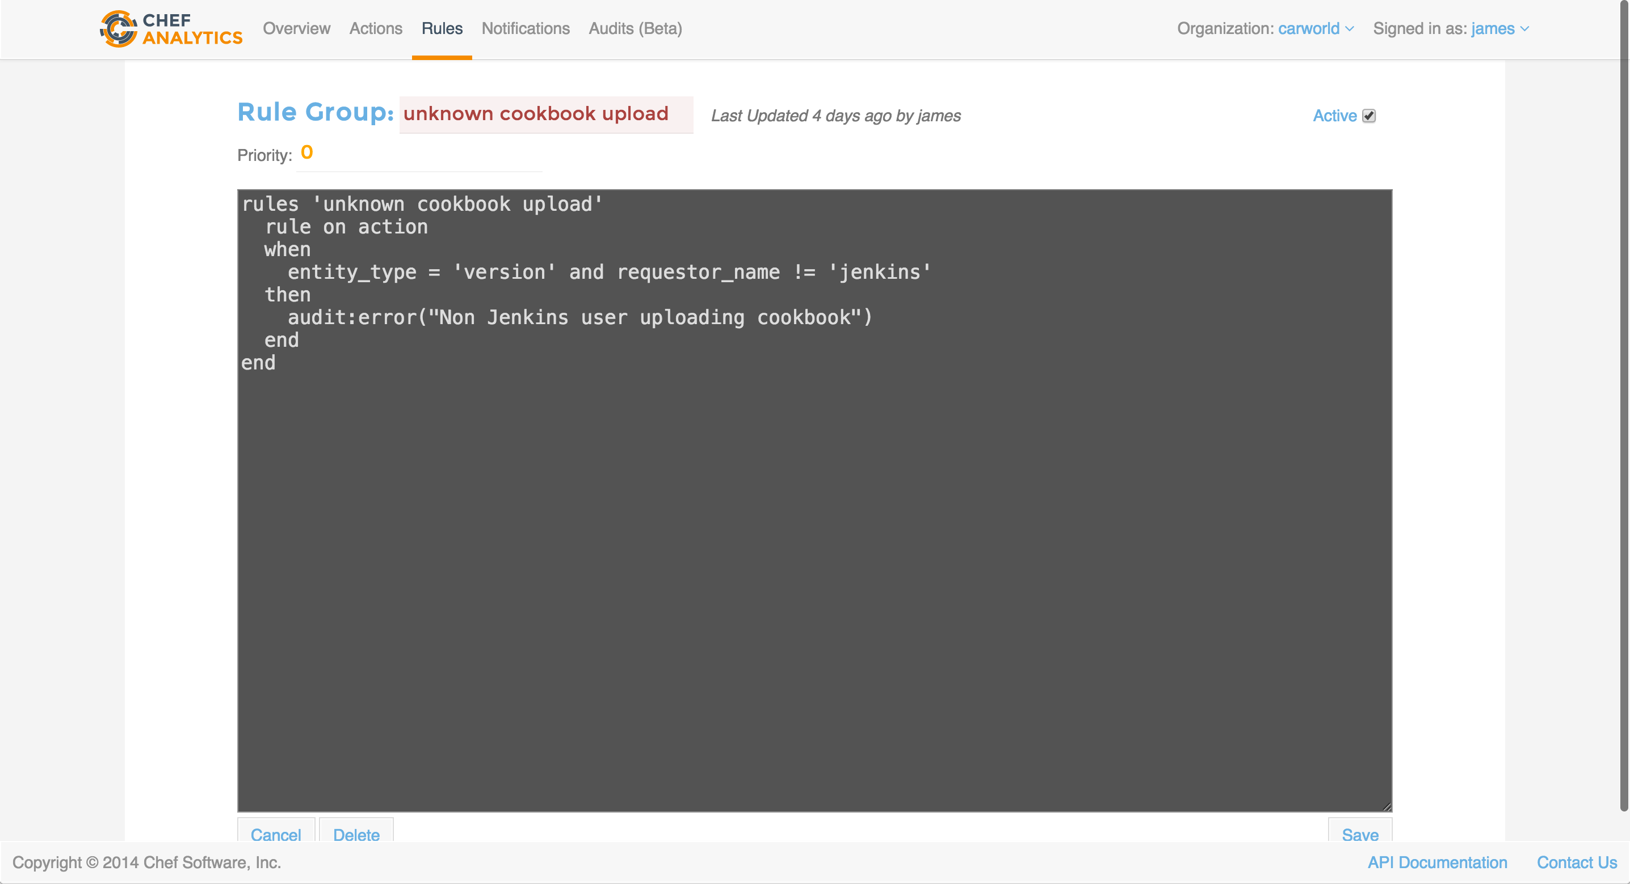

Slide 70
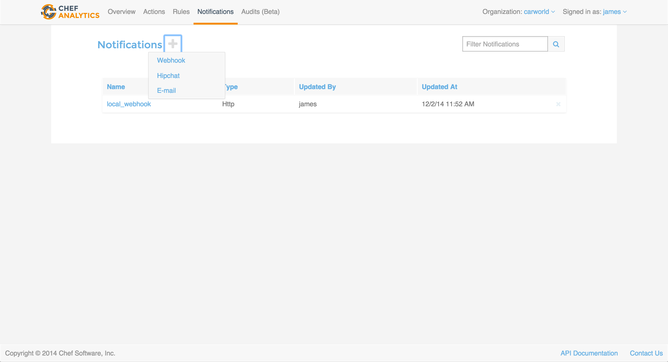

Slide 71
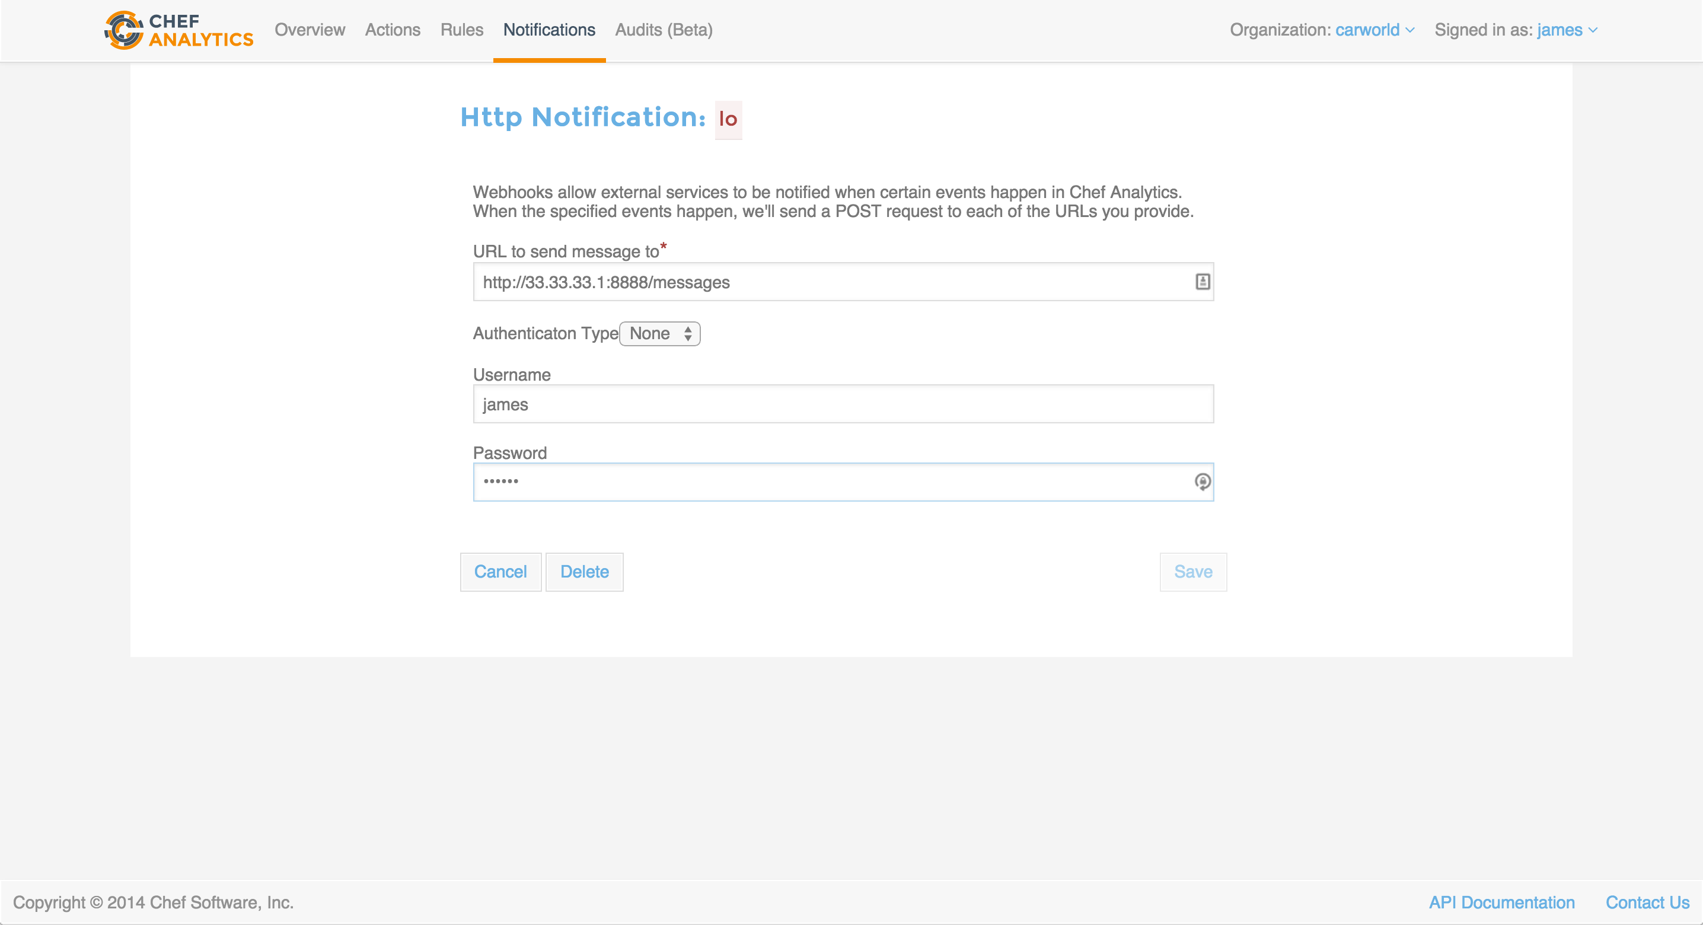

Slide 72
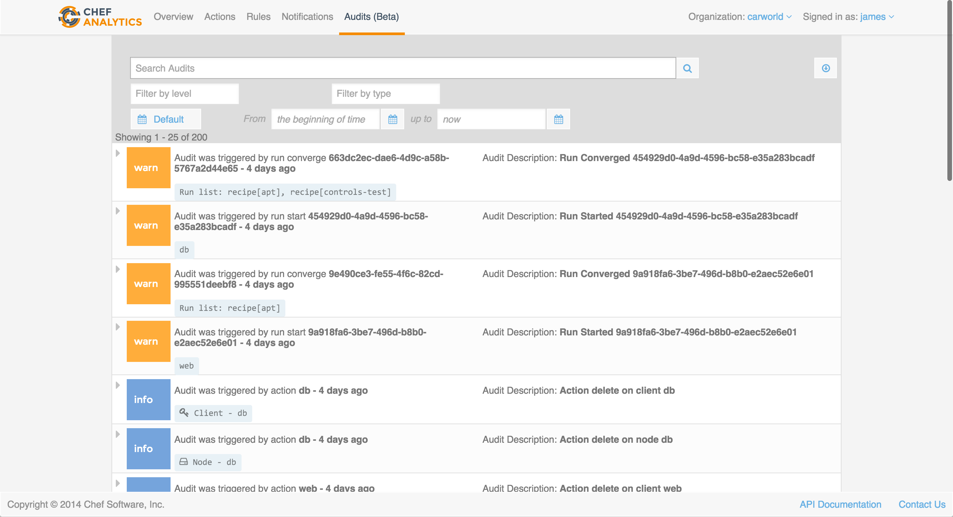

Slide 73
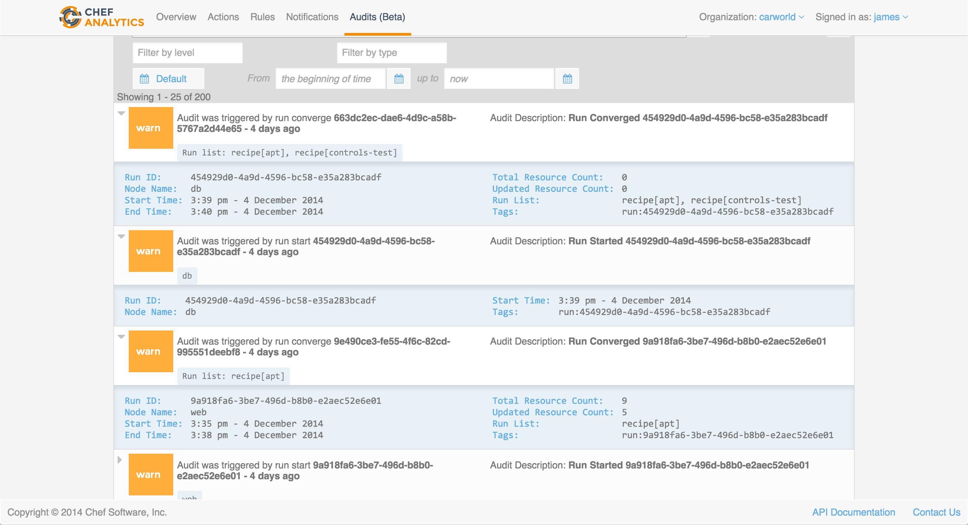

Slide 74
Example Rules

Slide 75
Controls - PCI Compliance
PCI 2.3 - Encrypt all non-console administrative access such as browser/Web-based management tools.
Control
Rule
controls 'port compliance' do
control port(23) do
it "has nothing listening"
expect(port(23)).to_not be_listening
end
end
end
rules ’PCI 2.3 – Confirm telnet port not available'
rule on run_control
when
name = 'should be listening’ and
resource_type = 'port’ and
resource_name = '23’ and
status != 'success'
then
audit:error("PCI 2.3 - Encrypt all non-console administrative access such as browser/Web-based management tools.")
notify("security-team@financialcorp.com”)
end
end

Slide 76
Controls - SOX Compliance
SOX Section 302.4.B – Establish verifiable controls to track data access.
Control
Rule
controls 'password authentication' do
control file('/etc/ssh/sshd_config') do
it "is disabled"
expect(file('/etc/ssh/sshd_config')) .to match(/PasswordAuthentication\s+no/)
end
end
end
rules 'SOX Section 302.4.B - force key based auth'
rule on run control
when
name = 'is disabled’ and
resource_type = 'File’ and
resource_name = '/etc/ssh/sshd_config’ and
status = 'failed'
then
audit:error("SOX Section 302.4.B – Establish verifiable controls to track data access.")
notify('security-team')
end
end

Slide 77
CYOA
High Availability
Replication
Client / Server Compatibility
AIX
Partial Search
Platform-specific values
Encrypted Databags
shell_out
OS X
Windows
Client-side key generation
Supermarket
Ruby versions
Chef Analytics
Chef Development Kit
Chef Provisioning
Roadmap
Chef in DC
Ask me Anything

Slide 78
Chef Development Kit

Slide 79
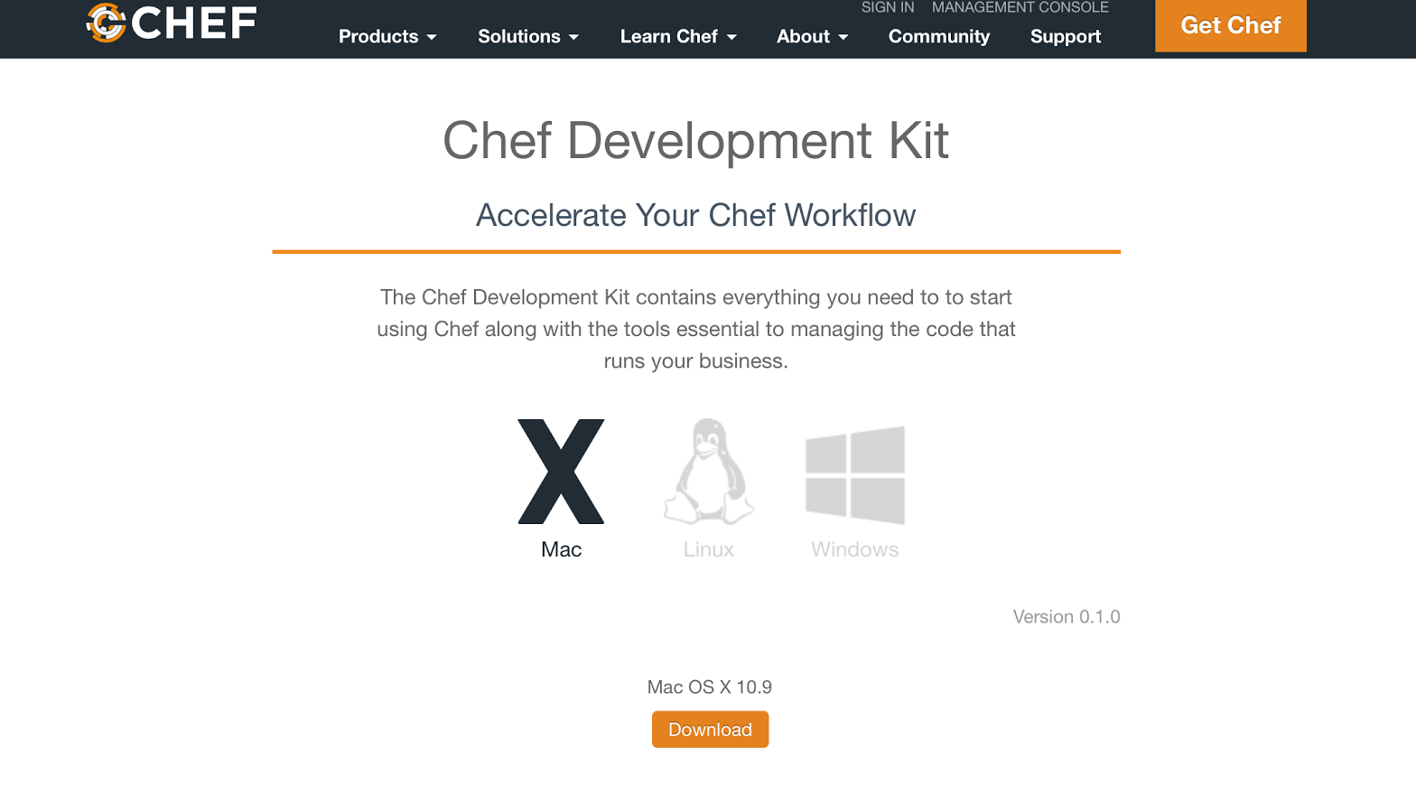
Increase CHEF adoption through ChefDK
ChefDK: CHEF Software Development Kit, fully supported with the Chef Premium Subscription
Workflow Definition: Our recommendation on the process to test and verify your infrastructure code before committing it to source control and shipping it to production.
Workflow Enhancement: Based on customer feedback and use cases

Slide 80
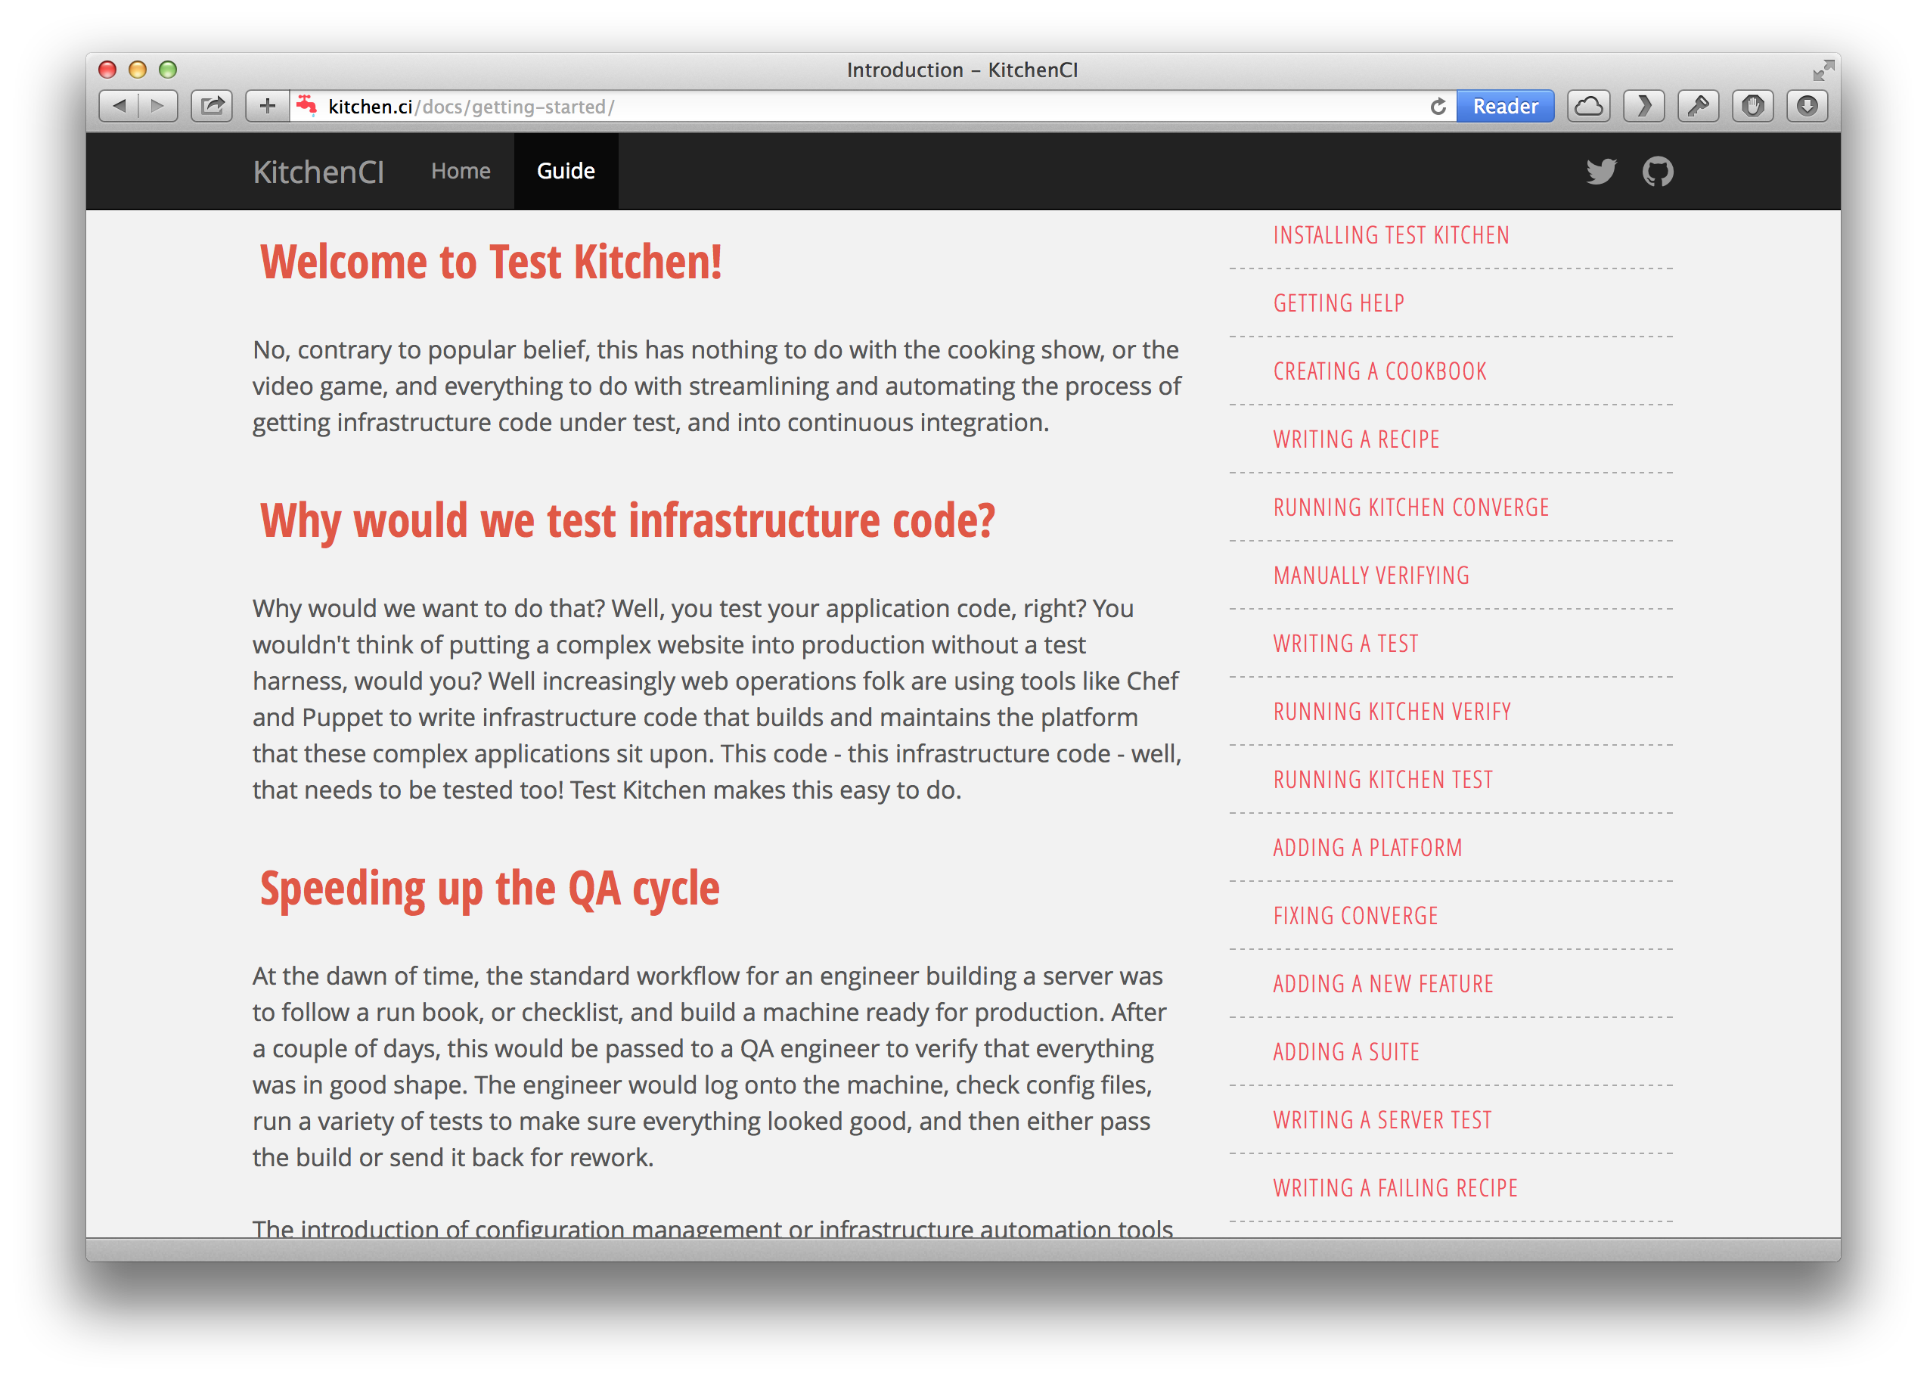
ChefDK: In the Box
First Class Support on Windows, Linux, and OSX for the entire suite of Chef development tools
Test Kitchen: Virtualized testing harness
Berkshelf: Dependency solver
Chef-Vault: Secrets management
Rubocop / Foodcritic: Code linting
Chefspec: In-memory Unit Testing
Chef.bin: New wrapper binary to tie it all together, with new extensible cookbook generators.

Slide 81
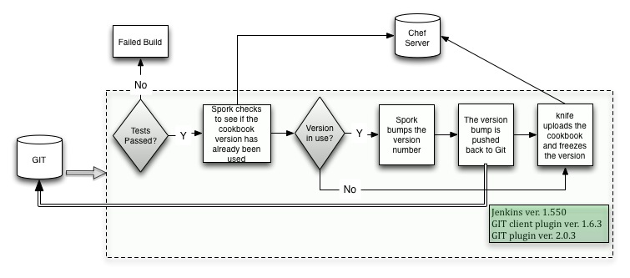
ChefDK: Knife-Spork Workflow Example

Slide 82
The Chef workflow
Create new skeleton cookbook.
Create a VM environment for cookbook development.
Write/debug cookbook recipes (iterative step).
Perform acceptance tests.
Deploy to production.

Slide 83
The Chef workflow with tools
Create new skeleton cookbook.
Create a VM environment for cookbook development.
Write/debug cookbook recipes (iterative step).
Perform acceptance tests.
Deploy to production.
Cookbook package manager (Berkshelf)
Revision control system (Git)
VM manager (Vagrant)
Ruby package manager (bundler)
Source editor (Sublime, etc.)
Revision control system (Git)
Ruby static checking (rubocop)
Chef static checking (foodcritic)
Chef unit testing (chefspec)
Integration tests (serverspec, RSpec, BATS, etc.)
Test harness (test-kitchen)
Chef local execution (chef-solo, chef-zero)
Chef server environment (Enterprise Chef , which includes Chef analytics)
Test harness (test-kitchen)
Acceptance tests (Gherkin, Cucumber, Leibniz)
Chef server environment (Enterprise Chef , which includes Chef analytics)

Slide 84
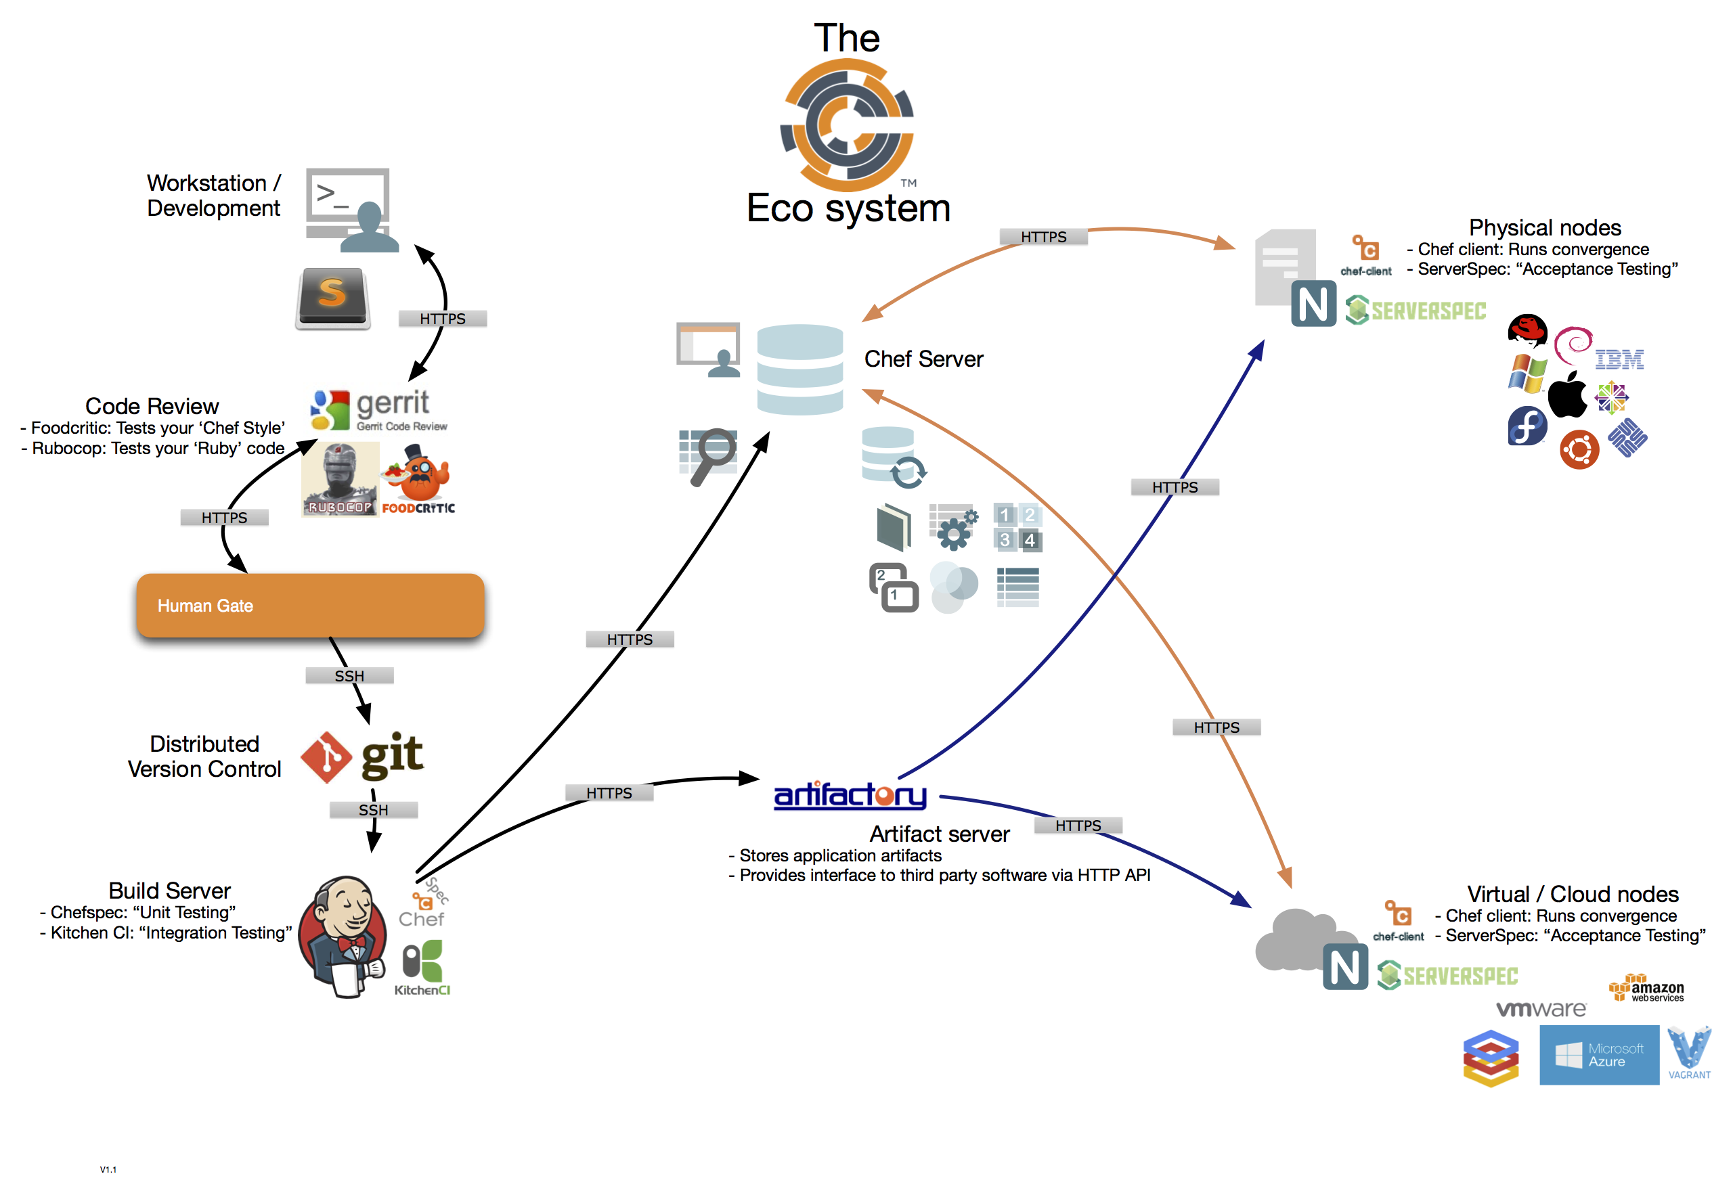
ChefDK: Knifeless Workflow Example

Slide 85
CYOA
High Availability
Replication
Client / Server Compatibility
AIX
Partial Search
Platform-specific values
Encrypted Databags
shell_out
OS X
Windows
Client-side key generation
Supermarket
Ruby versions
Chef Analytics
Chef Development Kit
Chef Provisioning
Roadmap
Chef in DC
Ask me Anything

Slide 86
Chef Provisioning

Slide 87
Chef Lifecycle
Provision a server, virtual machine, or cloud instance
Install Chef
Configure Chef
Run Chef
GOTO step 4
Notes:
So we have written some Chef code, and we are eager to get it out in front of some people running in AWS. Of course the aws-cli and ec2-tools are an option for bringing the instances up, but we will still have the added step of installing Chef and getting our code on our test instances.

Slide 88
knife bootstrap
Provision a server, virtual machine, or cloud instance
Install Chef
Configure Chef
Run Chef
GOTO step 4

Slide 89
Provisioning in AWS
Let’s use AWS as our case study
We’ll look at the various ways Chef can help you provision instances there

Slide 90
knife ec2 server create -I ami-4ab46b3d -f t1.micro -g sg-884f2eed,sg-8b4f2eee --ssh-user ubuntu -N nathen_hw_knife -r "recipe[hello_world]"
ec2-54-77-67-44.eu-west-1.compute.amazonaws.com Chef Client finished, 85/149 resources updated in 38.998005693 seconds
Instance ID: i-80d76866
Flavor: t1.micro
Image: ami-4ab46b3d
Region: eu-west-1
Availability Zone: eu-west-1a
Security Groups: default
Security Group Ids: sg-884f2eed, sg-8b4f2eee
Tags: Name: nathen_hw_knife
SSH Key: chef-nathenharvey-eu
Root Device Type: ebs
Root Volume ID: vol-602e1f7c
Root Device Name: /dev/sda1
Root Device Delete on Terminate: true
Public DNS Name: ec2-54-77-67-44.eu-west-1.compute.amazonaws.com
Public IP Address: 54.77.67.44
Private DNS Name: ip-172-31-2-160.eu-west-1.compute.internal
Private IP Address: 172.31.2.160
Environment: _default
Run List: recipe[hello_world]

Slide 91

knife ec2
“Infrastructure as Command Line” instead of “Infrastructure as Code”
What if I want many instances?
What if I want multiple tiers of instances?
https://flic.kr/p/eycPj7

Slide 92
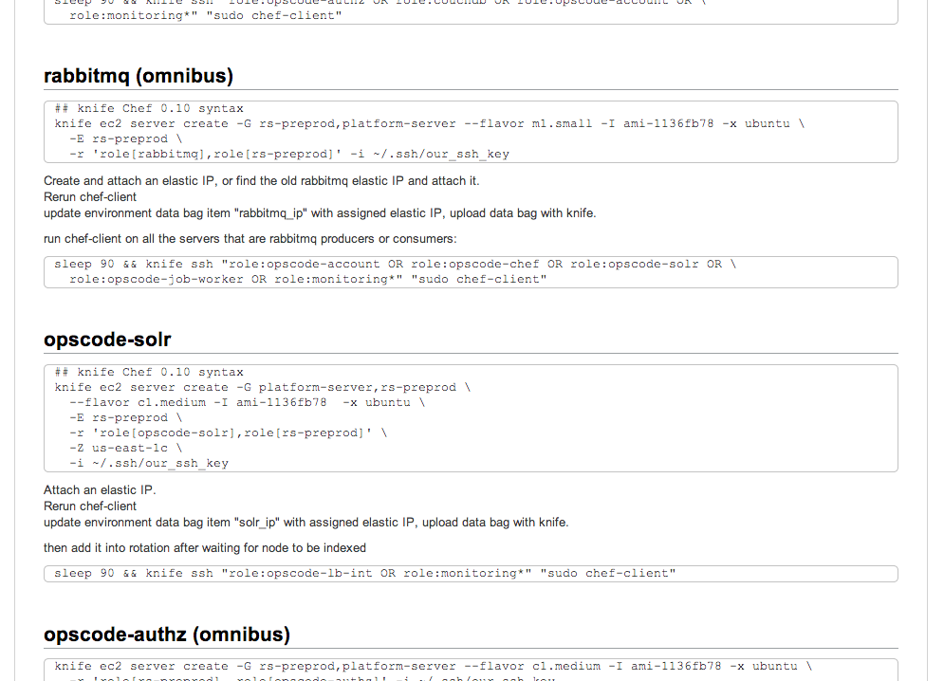
The classic operations playbook
Notes:
Those of us that have done operations and development should be familiar with the classic playbook for spinning up infrastructure. step-by-step instructions to be followed to bring your servers online. If you were lucky they existed someplace like a wiki, or document repository, but more often than not they might be in some notebook, or on the back of napkin somewhere
and remembering all of those commands is not easy...well it isn’t easy for me

Slide 93
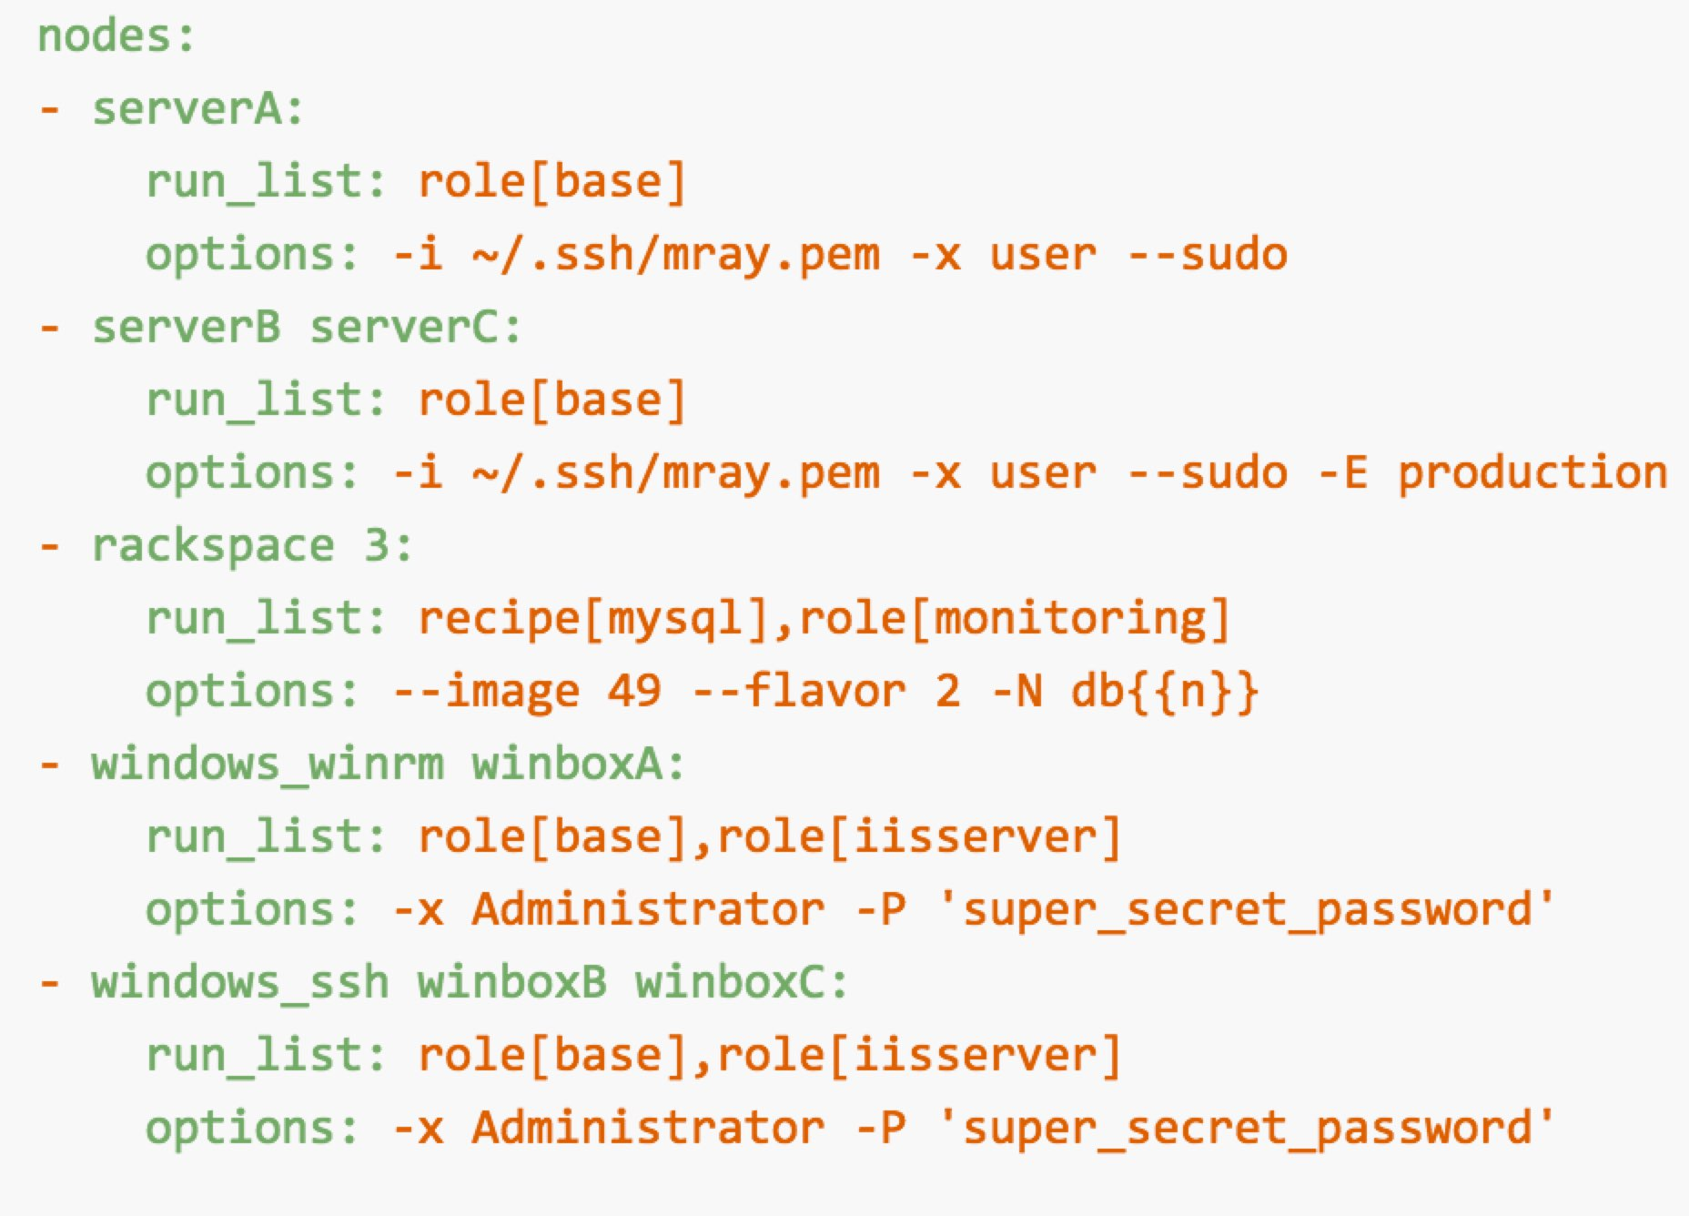
Spiceweasel
Command-line tool for batch loading Chef infrastructure
Generate and executes knife commands
https://github.com/mattray/spiceweasel
Notes:
Better but still lots of issues, including that you need to learn a new tool, new syntax, etc.

Slide 94

Chef Provisioning
Allows creation of instances in Chef Recipes
Allows for more programmatic creation
Allows for multiple tiers to be created in one shot
Moves more towards “Infrastructure as Code”
https://flic.kr/p/knDPjc

Slide 95
Chef Provisioning
machine ‘web1’ do
recipe ‘apache’
end

Slide 96
Chef Provisioning - Drivers
AWS
Azure
Fog
Vagrant
Docker
LXC
Hanlon
…and more
machine ‘web1’ do
recipe ‘apache’
end

Slide 97
The classic operations playbook
https://flic.kr/p/eycPj7

Slide 98
Chef Provisioning
require 'chef/provisioning'
machine_batch do
machines %w(primary secondary web1 web2)
end
machine_batch do
machine 'primary' do
recipe 'initial_ha_setup'
end
end
machine_batch do
machine 'secondary' do
recipe 'initial_ha_setup'
end
end
machine_batch do
%w(primary secondary).each do |name|
machine name do
recipe 'rest_of_my_configuration'
end
end
end
Notes:
Which allows you to write a recipe like this…

Slide 99
Configure Chef Provisioning
Installed as part of Chef Development Kit
Configure AWS
Create an AWS credentials file
Gems
chef-provisioning
chef-provisioning-aws

Slide 100
AWS Credentials File
~/.aws/config
[default]
Region=us-east-1
aws_access_key_id = <AWS_ACCESS_KEY_ID>
aws_secret_access_key = <AWS_SECRET_ACCESS_KEY>

Slide 101
Simple Example
require 'chef/provisioning/aws_driver'
with_driver 'aws'
machine 'nathen_web1' do
recipe 'hello_world'
end

Slide 102
Execute the Recipe
chef-client --local-mode simple.rb
[2015-02-04T12:53:22+00:00] INFO: Started chef-zero at http://localhost:8889 with repository at /Users/nathenharvey/chef_london_users/chef-repo
One version per cookbook
[2015-02-04T12:53:22+00:00] INFO: Forking chef instance to converge...
Starting Chef Client, version 12.0.3
[2015-02-04T12:53:22+00:00] INFO: *** Chef 12.0.3 ***
[2015-02-04T12:53:22+00:00] INFO: Chef-client pid: 23233
[2015-02-04T12:53:31+00:00] INFO: Run List is []
[2015-02-04T12:53:31+00:00] INFO: Run List expands to []
[2015-02-04T12:53:31+00:00] INFO: Starting Chef Run for nharveycul215
[2015-02-04T12:53:31+00:00] INFO: Running start handlers
[2015-02-04T12:53:31+00:00] INFO: Start handlers complete.
[2015-02-04T12:53:31+00:00] INFO: HTTP Request Returned 404 Not Found : Object not found: /reports/nodes/nharveycul215/runs
resolving cookbooks for run list: []
[2015-02-04T12:53:31+00:00] INFO: Loading cookbooks []
Synchronizing Cookbooks:
Compiling Cookbooks...
[2015-02-04T12:53:35+00:00] WARN: Node nharveycul215 has an empty run list.
Converging 7 resources
Recipe: @recipe_files::/Users/nathenharvey/chef_london_users/chef-repo/web.rb

Slide 103
Test and Repair
Resources follow a test and repair model
machine 'nathen_web1'

Slide 104
Test and Repair
Resources follow a test and repair model
machine 'nathen_web1'
Test
nathen_web1 exist?
Yes

Slide 105
Test and Repair
Resources follow a test and repair model
machine 'nathen_web1'
Test
nathen_web1 exist?
Yes
Done

Slide 106
Test and Repair
Resources follow a test and repair model
machine 'nathen_web1'
Test
nathen_web1 exist?
Yes
No
Done

Slide 107
Test and Repair
Resources follow a test and repair model
machine 'nathen_web1'
Test
nathen_web1 exist?
Yes
No
Done
Create it

Slide 108
Test and Repair
Resources follow a test and repair model
machine 'nathen_web1'
Test
nathen_web1 exist?
Yes
No
Repair
Done
Create it

Slide 109
Behold! The power of a loop
Need multiple instances?
That’s easy!
num_webservers = 3
(0...num_webservers).each do |i|
machine "nathen_web_0#{i}" do
recipe "hello_world"
end
end

Slide 110
More with AWS
Security Groups
Elastic Load Balancers
VPCs
Auto Scaling Groups
SQS Queues
…and more
https://github.com/chef/chef-provisioning-aws

Slide 111
Security Group
with_data_center 'us-east-1' do
aws_security_group "nathen-provisioning-security-group" do
inbound_rules [
{:ports => 22, :protocol => :tcp, :sources => ["0.0.0.0/0"] },
{:ports => 80, :protocol => :tcp, :sources => ["0.0.0.0/0"] }
]
end
end

Slide 112
Security Groups
{
"id": "nathen-provisioning-security-group",
"security_group_id": "sg-1d452878"
}
Information is stored in data bag items

Slide 113
Load Security Group ID
security_group = data_bag_item('aws_security_groups',
'nathen-provisioning-security-group')
security_group_id = security_group['security_group_id']

Slide 114
Use the Security Group
with_machine_options :bootstrap_options => {
:instance_type => 't1.micro',
:security_group_ids => [security_group_id]
}

Slide 115
Elastic Load Balancer
load_balancer "nathen-elb" do
load_balancer_options :availability_zones => ['us-east-1a', 'us-east-1c', 'us-east-1d', 'us-east-1e'],
:listeners => [{
:port => 80,
:protocol => :http,
:instance_port => 80,
:instance_protocol => :http,
}]
machines machine_names
end

Slide 116
Provisioning Production Environments

Slide 117

Chef Provisioning – Provisioning Node
Chef Server
AWS

Slide 118
Chef Provisioning – Provisioning Node
Chef Server
$ knife ec2 server create \
--node-name provisioner-node-1 \
--run-list “recipe[provision]”, “recipe[provision::orchestration]”
AWS

Slide 119
Chef Provisioning – Provisioning Node
Chef Server
provisioner-node-1
$ knife ec2 server create \
--node-name provisioner-node-1 \
--run-list “recipe[provision]”, “recipe[provision::orchestration]”
AWS

Slide 120
Chef Provisioning – Provisioning Node
Chef Server
provisioner-node-1
$ knife ec2 server create \
--node-name provisioner-node-1 \
--run-list “recipe[provision]”, “recipe[provision::orchestration]”
AWS

Slide 121
Chef Provisioning – Provisioning Node
require 'chef/provisioning'
machine_batch do
machines %w(primary secondary web1 web2)
end
machine_batch do
machine 'primary' do
recipe 'initial_ha_setup'
end
end
machine_batch do
machine 'secondary' do
recipe 'initial_ha_setup'
end
end
machine_batch do
%w(primary secondary).each do |name|
machine name do
recipe 'rest_of_my_shit'
end
end
end
Chef Server
provisioner-node-1
AWS

Slide 122
Chef Provisioning – Provisioning Node
primary
secondary
web1
web2
require 'chef/provisioning'
machine_batch do
machines %w(primary secondary web1 web2)
end
machine_batch do
machine 'primary' do
recipe 'initial_ha_setup'
end
end
machine_batch do
machine 'secondary' do
recipe 'initial_ha_setup'
end
end
machine_batch do
%w(primary secondary).each do |name|
machine name do
recipe 'rest_of_my_shit'
end
end
end
Chef Server
provisioner-node-1
AWS

Slide 123
Chef Provisioning – Provisioning Node
primary
secondary
web1
web2
Chef Server
provisioner-node-1
AWS

Slide 124
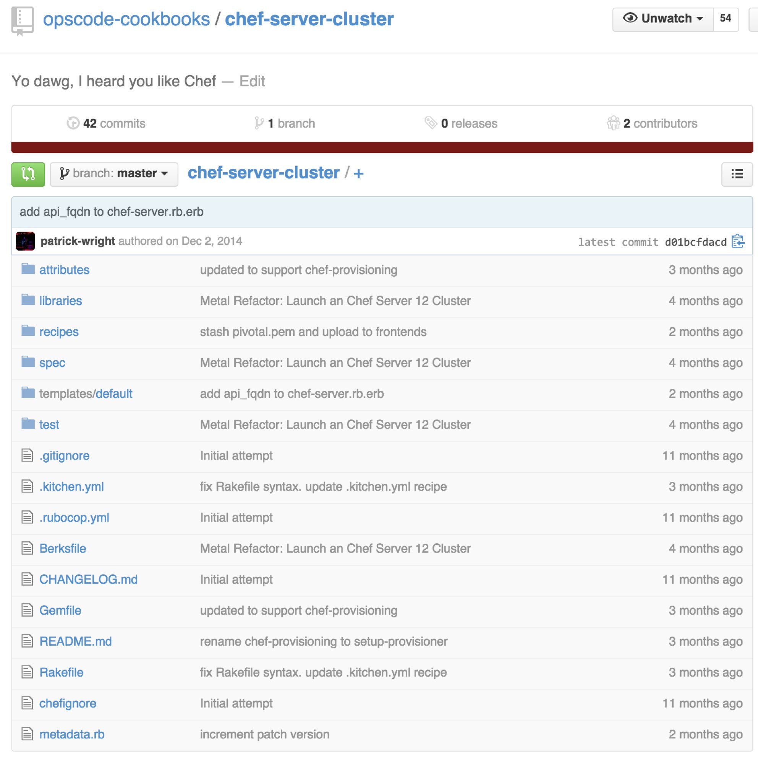
chef-server-cluster
chef-server-cluster Cookbook
Built On chef-provisioning
Stand up Chef Server 12 AWS in a tiered configuration
Stand up Analytics
https://github.com/opscode-cookbooks/chef-server-cluster

Slide 125
Chef Provisioning Recap
Machine resource for creating instances
Drivers for many providers
Programmatically declare your infrastructure as code
Testable
Repeatable
Notes:
Tiered is sufficient to test performance because even in HA, only one backend is active at any time anyways, so the performance would be the same.
Backend tuning used:
PostgreSQL max connections = 1500
Erchef:
depsolver_worker_count = 4
depsolver_timeout = 120000
db_pool_size = 100
AuthZ:
http_init_count = 100
http_max_count = 100
Bifrost:
db_pool_size = 100
Certificate:
Num_workers = 4
Max_certificates_per_worker = 1000
For specific tuning guidance for each customer, discuss with success engineering.

Slide 126
What’s on the horizon?
Version 1.0 coming soon!
IAM Roles support
More resources…
Notes:
Tiered is sufficient to test performance because even in HA, only one backend is active at any time anyways, so the performance would be the same.
Backend tuning used:
PostgreSQL max connections = 1500
Erchef:
depsolver_worker_count = 4
depsolver_timeout = 120000
db_pool_size = 100
AuthZ:
http_init_count = 100
http_max_count = 100
Bifrost:
db_pool_size = 100
Certificate:
Num_workers = 4
Max_certificates_per_worker = 1000
For specific tuning guidance for each customer, discuss with success engineering.

Slide 127
How you can contribute
Use it
Fork the repositories
Write new drivers
Add resources
Open issues
Notes:
Tiered is sufficient to test performance because even in HA, only one backend is active at any time anyways, so the performance would be the same.
Backend tuning used:
PostgreSQL max connections = 1500
Erchef:
depsolver_worker_count = 4
depsolver_timeout = 120000
db_pool_size = 100
AuthZ:
http_init_count = 100
http_max_count = 100
Bifrost:
db_pool_size = 100
Certificate:
Num_workers = 4
Max_certificates_per_worker = 1000
For specific tuning guidance for each customer, discuss with success engineering.

Slide 128
Where to go from here
Chef-provisioning https://github.com/chef/chef-provisioning
Chef-provisioning-aws https://github.com/chef/chef-provisioning-aws
Gitter IM Channel https://gitter.im/chef/chef-provisioning
Notes:
Some examples of CloudFormation templates, updated for Chef Server 12, are in https://github.com/opscode/chef-server-cloudformation-templates
Writing a CFN template for HA is much trickier so I haven't done it yet. You need to attach the data volume EBS to the primary, LVM/format it as part of the build of the PrimaryBackend, so we can't declare the VolumeAssociation as a separate element.
CloudFormation is also useful for orchestrating the correct installation order:
- Bootstrap backend server first
- Put bootstrap data in autocreated S3 bucket
- Autoscaling group for N frontends
- Each frontend on bootup grabs backend data from S3, then does p-c-c reconfigure
You can eliminate bookshelf entirely and configure erchef to serve cookbooks out of S3

Slide 129
CYOA
High Availability
Replication
Client / Server Compatibility
AIX
Partial Search
Platform-specific values
Encrypted Databags
shell_out
OS X
Windows
Client-side key generation
Supermarket
Ruby versions
Chef Analytics
Chef Development Kit
Chef Provisioning
Roadmap
Chef in DC
Ask me Anything

Slide 130
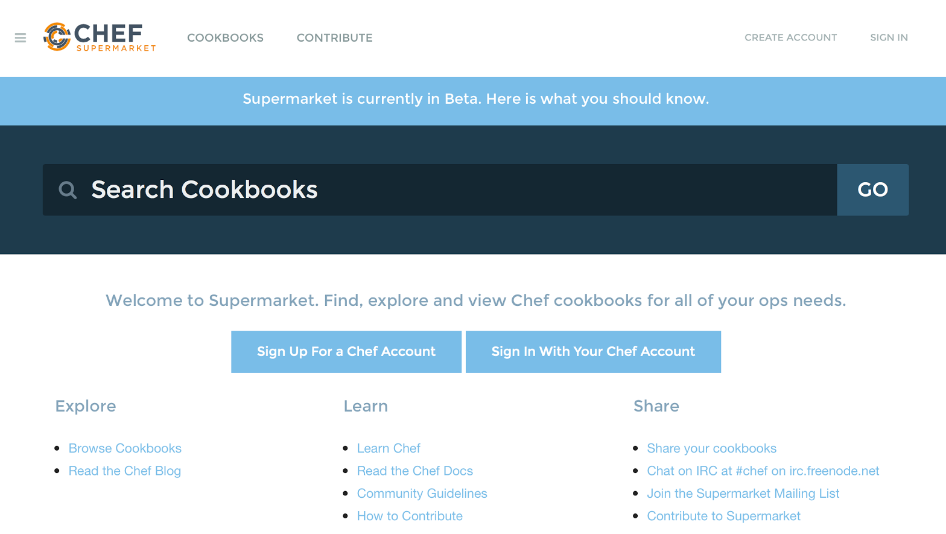
Community Cookbook Repo - Supermarket
It’s open source!
Anyone can leverage this collection of code and best practices
Organizations can host Supermarket internally/on-premise to empower their own technology community

Slide 131
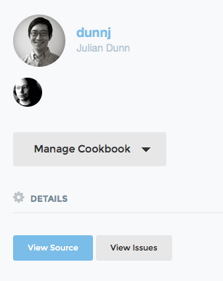
New Cookbook Metadata Fields
name is now mandatory
issues_url and source_url for integration with Supermarket

Slide 132
CYOA
High Availability
Replication
Client / Server Compatibility
AIX
Partial Search
Platform-specific values
Encrypted Databags
shell_out
OS X
Windows
Client-side key generation
Supermarket
Ruby versions
Chef Analytics
Chef Development Kit
Chef Provisioning
Roadmap
Chef in DC
Ask me Anything

Slide 133
Chef on Windows

Slide 134
Speed Improvements
Ruby 2.x improves garbage collection speed on Windows
Appbundler (Chef-developed product) resolves & locks dependencies at package build time
Like "bundler", but bundler resolves dependencies at runtime
More performance work planned in 2015
Ruby 2.1+ for Windows
Lazy loading of knife plugins
Speed up Ohai/minimize data collection

Slide 135
Reboot resource
# Reboot at end of Chef Client run
reboot "app_requires_it" do
action :request_reboot
reason "Need to reboot when the run completes successfully."
delay_mins 5
end
# Reboot now
reboot "app_requires_it_now" do
action :reboot_now
reason "Need to reboot right now."
end
Notes:
Supported not only on Windows but on OS X and Linux as well
Check that reporting captures the fact that not the entire resource collection was converged on a rebooting run

Slide 136
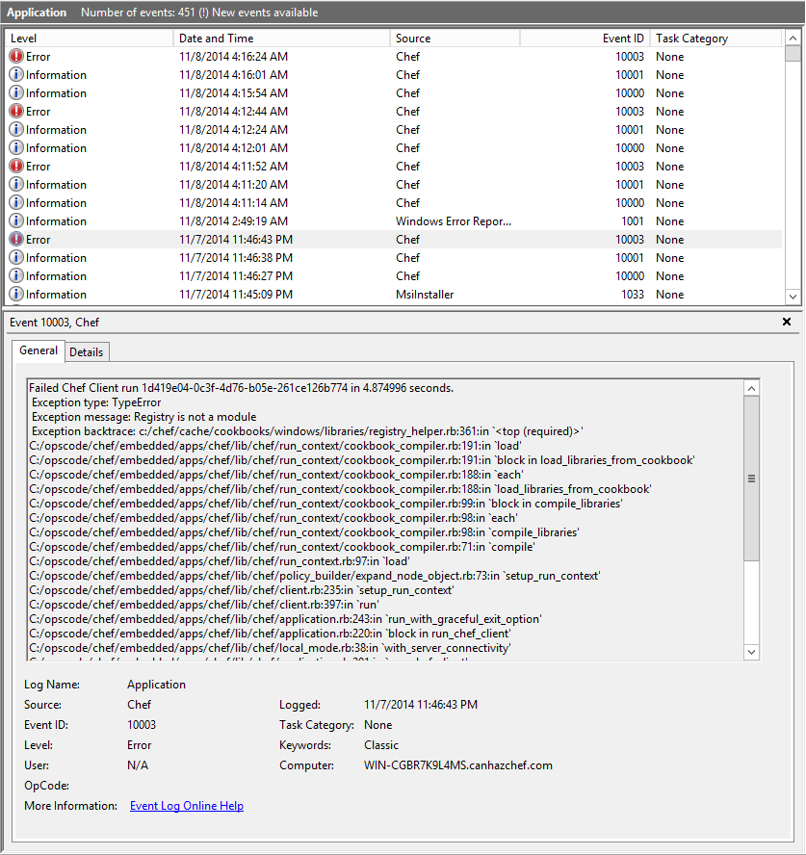
Windows Event Logging
Chef Client 12 on Windows logs to Application Event Log by default

Slide 137
Guard Interpreter Defaults
Guards: not_if/only_if expressions in resources
Guard interpreter: what the guard expression is executed with
 | Resource
Client Version | powershell_script | batch
11.x | 32-bit cmd.exe | 32-bit cmd.exe
12.x | 64-bit PowerShell | 64-bit cmd.exe
More information: http://tinyurl.com/guard-interpreter
Notes:
Level-set as to what a "guard" is

Slide 138
Windows Service Startup Type
windows_service "BITS" do
action :configure_startup
startup_type :manual
end
Must use windows_service to do this; :configure_startup action and startup_type are not supported by 'service'
Notes:
FAQ: Why didn't we just subclass the service provider?
Because Some attributes (like delayed start actions) only make sense on Windows
TODO: Find out whether the use of 'windows_service' is still required … because Lamont's dynamic provider resolver *should* coerce service to windows_service anyways

Slide 139

Windows PowerShell DSC
Comprehensive Integration
Multi-Platform Automation
- Easily automate Windows and Linux workloads in data center and Azure Cloud.
- Treat any DSC resource as a Chef resource.
- Improve collaboration between development and operations teams in heterogeneous environments.
Azure Integration
- Ease of configuration, automation and management.
- Microsoft Open Technologies has published a collection of three Chef cookbooks for configuring Azure Virtual Machines.
- Reduce risk, management, and development cycle times.

Slide 140

Chef on Windows
Cross-Platform resources:
file, remote_file, cookbook_file, template
directory, remote_directory
user, group
mount (can take CIFS paths)
env
service
execute
ruby_block
many others...

Slide 141

Chef on Windows
Unique to Windows:
registry_key (new in Chef 11.0.0)
powershell_script (new in Chef 11.6.0)
batch (new in Chef 11.6.0)
Automatic architecture handling (:i386 vs. :x86_64)
Automatic Windows filesystem redirector handling (Wow64)
Long-term roadmap:
Move all Windows-specific resources to core and out of ‘Windows’ cookbook

Slide 142
Chef on Windows
A few Windows-only cookbooks:
azure (Community)
chocolatey (Community)
eventlog (Community)
iis (Chef)
msoffice (Community)
powershell (Chef)
sql_server (Chef)
webpi (Chef)
windows (Chef)
wix (Chef)
A few of the Windows-specific helper functions in the language:
:registry_has_subkeys?
:registry_key_exists?
:registry_value_exists?
:windows_8_1?
:windows_server_2012_r2?
:marketing_name
:core? :cluster? :datacenter?
Many more!

Slide 143

Chef on Windows
The Windows Cookbook includes a number of additional resources and helper libraries.
See https://github.com/opscode-cookbooks/windows for a full list
Highlights:
windows_auto_run
windows_feature
windows_package
windows_path
windows_reboot
windows_zipfile
More: windows_printer, windows_printer_port, windows_task

Slide 144
Chef on Windows: DSC Integration (Released)
dsc_resource 'IIS' do
name 'Webserver'
resource :component
action :install
end
1:1 Mapping DSC resources to Chef resources
Challenges:
DSC is transactional, Chef is not
See it live: PowerChef: Enhanced PowerShell Integration for Chef Recipes
https://www.youtube.com/watch?v=BNV2jZUjKlc
Notes:
Previous slide – shows demo functionality

Slide 145
Chef on Windows: DSC Integration (Released)
dsc_script 'IIS' do
code <<-EOH
windowsfeature ‘iis’
{
name = ‘web-server’
}
EOH
end
Released – Embedding DSC configurations into Chef recipes with dsc_script
Upcoming – 1:1 Mapping DSC resources to Chef resources
Try it out with the DSC cookbook! https://supermarket.chef.io/cookbooks/dsc
See it live: Chef and Microsoft’s Desired State Configuration
https://www.youtube.com/watch?v=mXaAIawzNic
Notes:
Updated for the currently released (as of Chef Client 11.16.0) functionality

Slide 146
CYOA
High Availability
Replication
Client / Server Compatibility
AIX
Partial Search
Platform-specific values
Encrypted Databags
shell_out
OS X
Windows
Client-side key generation
Supermarket
Ruby versions
Chef Analytics
Chef Development Kit
Chef Provisioning
Roadmap
Chef in DC
Ask me Anything

Slide 147
Chef in 2015

Slide 148
Themes
Improving velocity at CHEF Software, Inc
Compliance at Velocity
Moar Integrations!
Management Console Delight
Broader Enterprise Offerings
TDI improvements and provisioning
Ecosystem made more awesome

Slide 149
Other Awesome Stuff
More than twirling dials and knobs
Configuration, Visibility, and Delivery at scale
Community Engineering group

Slide 150

ChefConf
http://chefconf.com

Slide 151
CYOA
High Availability
Replication
Client / Server Compatibility
AIX
Partial Search
Platform-specific values
Encrypted Databags
shell_out
OS X
Windows
Client-side key generation
Supermarket
Ruby versions
Chef Analytics
Chef Development Kit
Chef Provisioning
Roadmap
Chef in DC
Ask me Anything

Slide 152
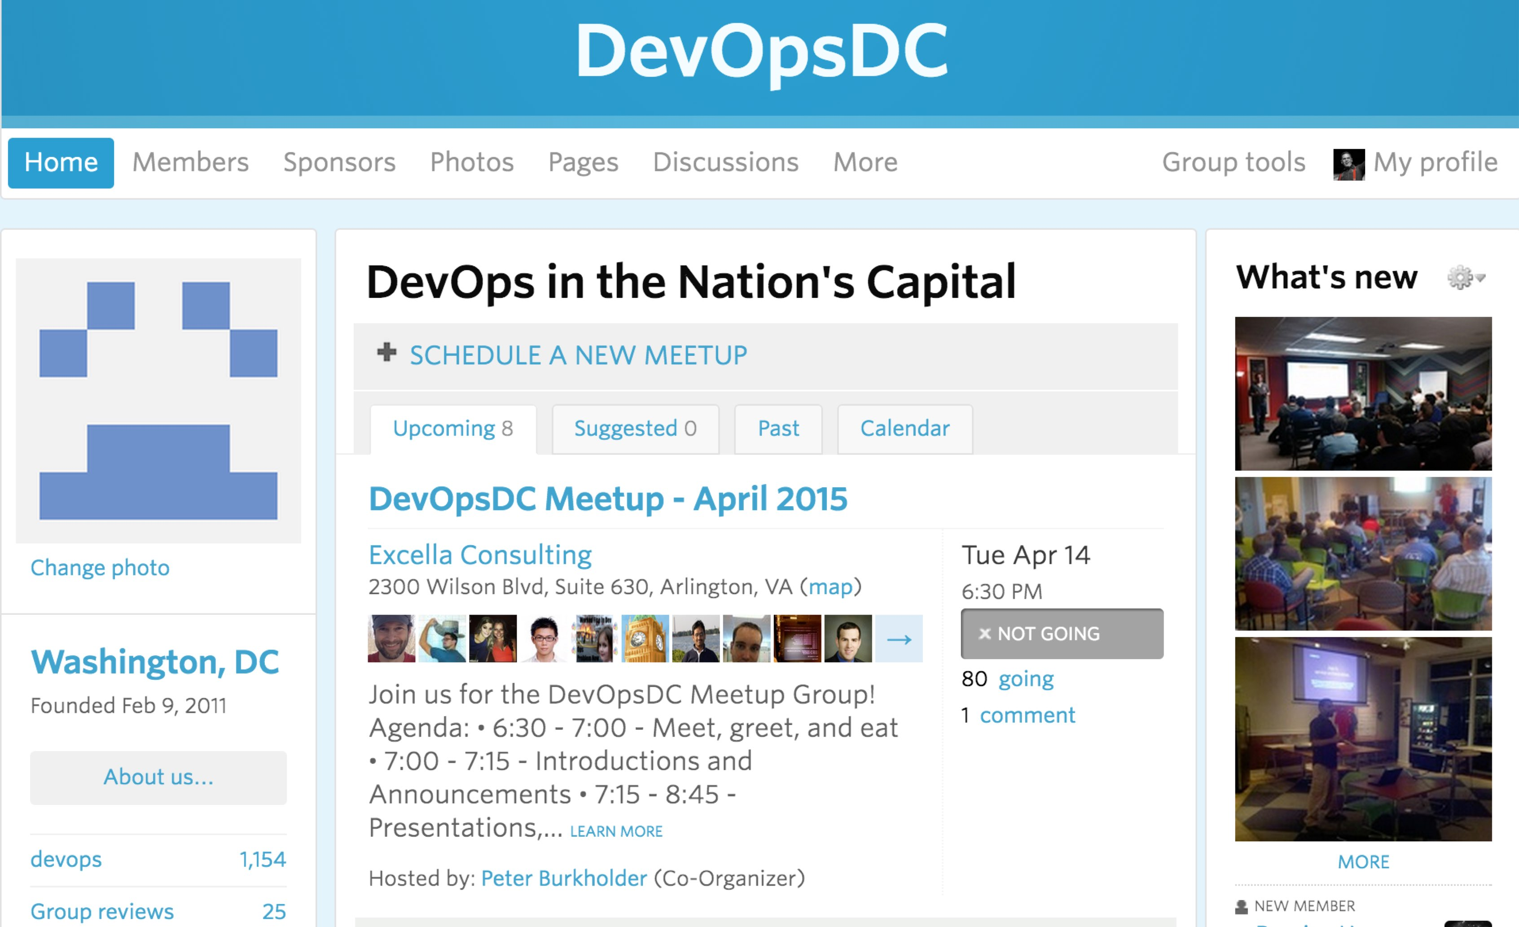
DevOps DC Meetup
http://www.meetup.com/DevOpsDC/

Slide 153
ChefConf
http://chefconf.com

Slide 154
Upcoming Chef Training
Chef Intermediate Topics – April 28-29
Chef Fundamentals – April 30-May 1
Discount code: MEETUP

Slide 155

DevOpsDays DC
June 11-12
USPTO, Alexandria
Now Open
Registration
CFP
Sponsorships
http://www.devopsdays.org/events/2015-washington-dc/

Slide 156
CYOA
High Availability
Replication
Client / Server Compatibility
AIX
Partial Search
Platform-specific values
Encrypted Databags
shell_out
OS X
Windows
Client-side key generation
Supermarket
Ruby versions
Chef Analytics
Chef Development Kit
Chef Provisioning
Roadmap
Chef in DC
Ask me Anything

Slide 157
Thank you!
What questions can I answer for you?
nharvey@chef.io
@nathenharvey
http://bit.ly/farmer-nathen (explicit)
http://bit.ly/farmer-nathen-sfw

Slide 158
CYOA
High Availability
Replication
Client / Server Compatibility
AIX
Partial Search
Platform-specific values
Encrypted Databags
shell_out
OS X
Windows
Client-side key generation
Supermarket
Ruby versions
Chef Analytics
Chef Development Kit
Chef Provisioning
Roadmap
Chef in DC
Ask me Anything

